Slide 1


DW - 101
Last Updated : October 2008
eTPG (DW-BI) – BTS (FS &TMT)

Slide 2
Objectives
At the end of this lesson, you will know :
Overview of Data Warehousing
Evolution of Data Warehousing
Need for Data Warehousing
OLTP Vs Warehouse Applications
Data marts Vs Data Warehouses
Operational Data Stores
Warehouse Architecture
Warehouse components
Introduction to Data modeling concept
Introduction to ETL Concept (DI-101)
Introduction to OLAP Concept (BI-101)

Slide 3
What is a Data Warehouse ?
Can I see credit report from Accounts, Sales from marketing and open order report from order entry for this customer
Data from multiple sources is integrated for a subject
A data warehouse is a subject-oriented, integrated, nonvolatile, time-variant collection of data in support of management's decisions.
- WH Inmon
Identical queries will give same results at different times. Supports analysis requiring historical data
Data stored for historical period. Data is populated in the data warehouse on daily/weekly basis depending upon the requirement.
WH Inmon - Regarded As Father Of Data Warehousing

Slide 4
Subject-Oriented- Characteristics of a Data Warehouse
Operational
Data
Warehouse
Leads
Prospects
Customers
Products
Quotes
Regions
Time
Orders
Focus is on Subject Areas rather than Applications

Slide 5
Integrated - Characteristics of a Data Warehouse
Appl A - m,f
Appl B - 1,0
Appl C - male,female
m,f
Appl A - balance dec fixed (13,2)
Appl B - balance pic 9(9)V99
Appl C - balance pic S9(7)V99 comp-3
balance dec
fixed (13,2)
Appl A - bal-on-hand
Appl B - current-balance
Appl C - cash-on-hand
Current balance
Appl A - date (julian)
Appl B - date (yymmdd)
Appl C - date (absolute)
date (julian)
Integrated View Is The Essence Of A Data Warehouse

Slide 6
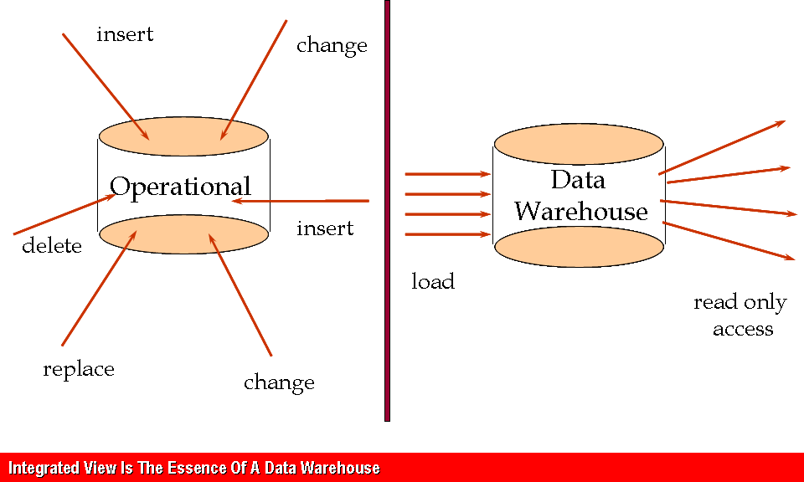
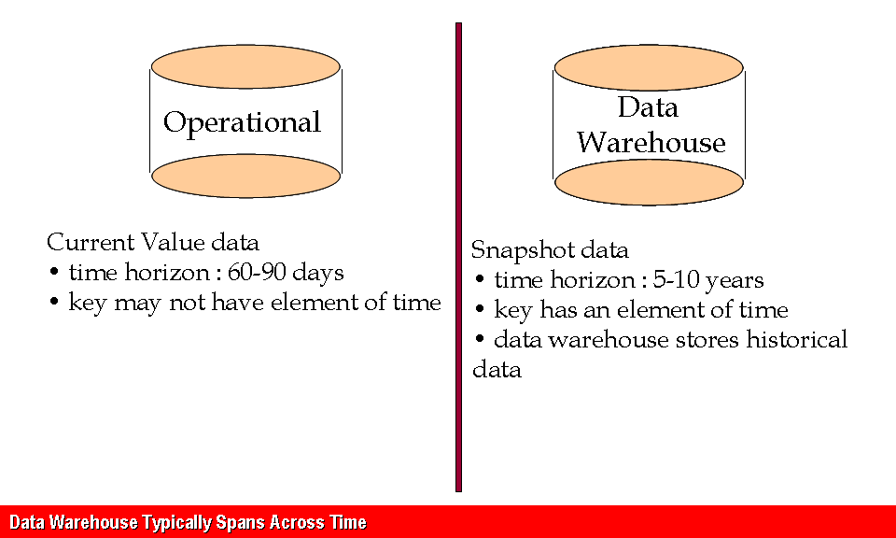
Characteristics of a Data Warehouse
Non Volatile
Time Variant

Slide 7
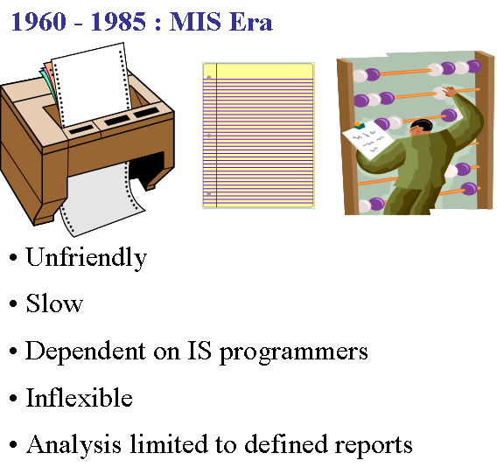
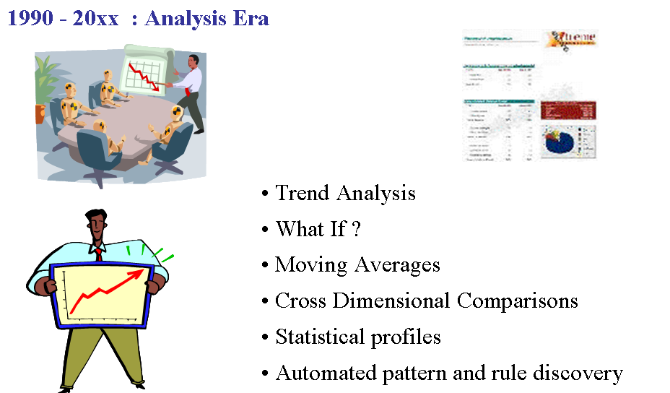
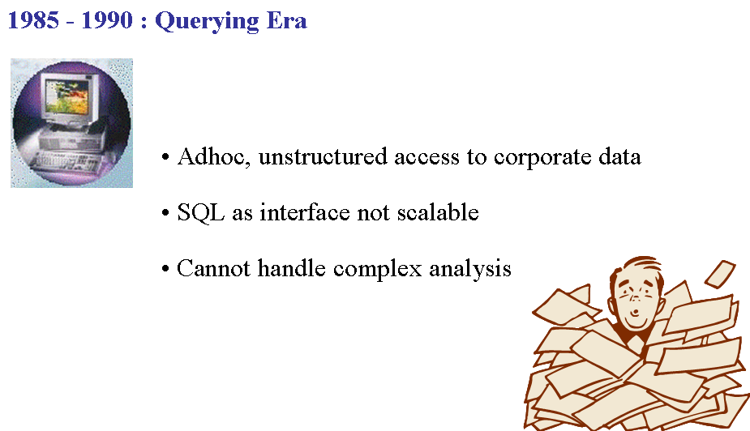
Evolution of Data Warehousing
Focus on Reporting

Slide 8
Need for Data Warehousing
Better business intelligence for end-users
Reduction in time to locate, access, and analyze information
Consolidation of disparate information sources
Strategic advantage over competitors
Faster time-to-market for products and services
Replacement of older, less-responsive decision support systems
Reduction in demand on IS to generate reports

Slide 9
OLTP Vs Warehouse
Operational System
Data Warehouse
Transaction Processing
Query Processing
Time Sensitive
History Oriented
Operator View
Managerial View
Organized by transactions (Order, Input, Inventory)
Organized by subject (Customer, Product)
Relatively smaller database
Large database size
Many concurrent users
Relatively few concurrent users
Volatile Data
Non Volatile Data
Stores all data
Stores relevant data
Not Flexible
Flexible

Slide 10
Do we need a separate database ?
OLTP and data warehousing require two very differently configured systems
Isolation of Production System from Business Intelligence System
Significant and highly variable resource demands of the data warehouse
Cost of disk space no longer a concern
Production systems not designed for query processing

Slide 11
Data Marts
Influence to have Data Marts:
Enterprise wide data warehousing projects have a very large cycle time
Getting consensus between multiple parties may also be difficult
Departments may not be satisfied with priority accorded to them
Application/database distribution is also an important factor
Definition:
Subject or Application Oriented Business View of Warehouse
Quick Solution to a specific Business Problem
Finance, Manufacturing, Sales etc.
Smaller amount of data used for Analytic Processing

Slide 12
Data Warehouse and Data Mart
Data Warehouse
Data Marts
Scope
Application Neutral
Centralized, Shared
Cross LOB/enterprise
Specific Application Requirement
LOB, department
Business Process Oriented
Data Perspective
Historical Detailed data
Some summary
Detailed (some history)
Summarized
Subjects
Multiple subject areas
Single Partial subject
Multiple partial subjects
Data Sources
Many
Operational/ External Data
Few
Operational, external data
Implement Time Frame
9-18 months for first stage
Multiple stage implementation
4-12 months
Characteristics
Flexible, extensible
Durable/Strategic
Data orientation
Restrictive, non extensible
Short life/tactical
Project Orientation

Slide 13
Operational Data Store
The ODS applies only to the world of operational systems.
The ODS contains current valued and near current valued data.
The ODS contains almost exclusively all detail data
The ODS requires a full function, update, record oriented environment.

Slide 14
Different kinds of Information Needs
Current
Recent
Historical
Is this medicine available in stock
What are the tests this patient has completed so far
Has the incidence of Tuberculosis increased in last 5 years in Southern region
OLTP
ODS
Data Warehouse

Slide 15
OLTP Vs ODS Vs DWH
Characteristic
OLTP
ODS
Data Warehouse
Audience
Operating Personnel
Analysts
Managers and analysts
Data access
Individual records, transaction driven
Individual records, transaction or analysis driven
Set of records, analysis driven
Data content
Current, real-time
Current and near-current
Historical
Data Structure
Detailed
Detailed and lightly summarized
Detailed and Summarized
Data organization
Functional
Subject-oriented
Subject-oriented
Type of Data
Homogeneous
Homogeneous
Vast Supply of very heterogeneous data

Slide 16
OLTP Vs ODS Vs DWH
Characteristic
OLTP
ODS
Data Warehouse
Data redundancy
Non-redundant within system; Unmanaged redundancy among systems
Somewhat redundant with operational databases
Managed redundancy
Data update
Field by field
Field by field
Controlled batch
Database size
Moderate
Moderate
Large to very large
Development Methodology
Requirements driven, structured
Data driven, somewhat evolutionary
Data driven, evolutionary
Philosophy
Support day-to-day operation
Support day-to-day decisions & operational activities
Support managing the enterprise

Slide 17

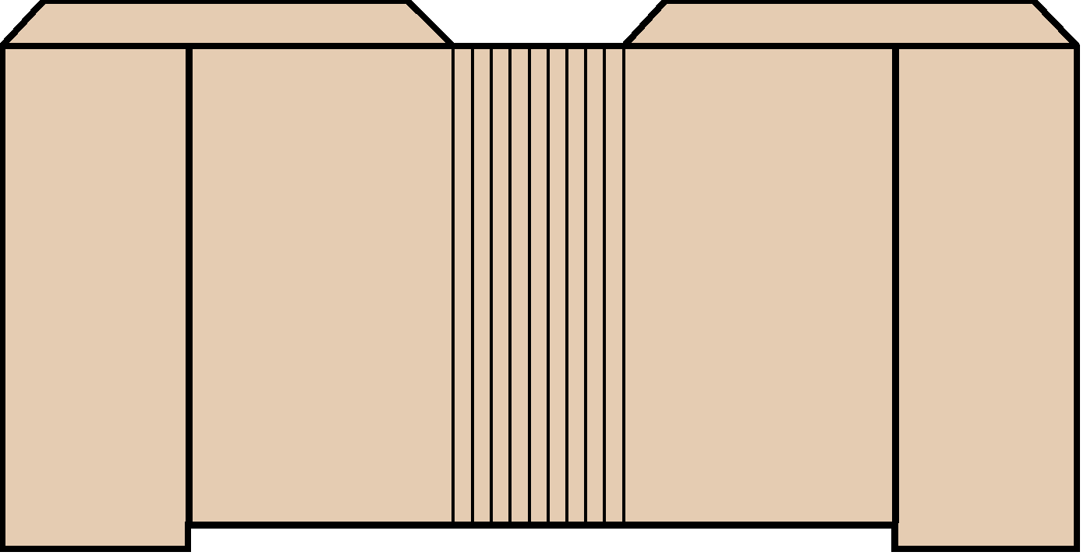




Typical Data Warehouse Architecture
Data
Marts
EIS /DSS
Metadata
Select
Extract
Transform
Integrate
Maintain
Query Tools
Data
Warehouse
OLAP/ROLAP
Web Browsers
Operational
Systems/Data
Middleware/
API
Data
Preparation
Data Mining
Multi-tiered Data Warehouse without ODS

Slide 18

Typical Data Warehouse Architecture
Data
Marts
Metadata
Metadata
Select
Extract
Transform
Integrate
Maintain
Select
Extract
Transform
Load
ODS
Data
Warehouse
Operational
Systems/Data
Data
Preparation
Data
Preparation
Multi-tiered Data Warehouse with ODS

Slide 19
Components of a Data Warehouse Architecture
Source Databases
Data extraction/transformation/load (ETL) tool
Data Cleansing tool
Data warehouse maintenance and administration tools
Data modeling tool or interface to external data models
Warehouse databases
End-user data access and analysis tools

Slide 20
Source Databases - Characteristics
Legacy, relational, text or external sources
Designed for high-speed transaction processing
Real-time, current, volatile data
Many short transactions
Update-intensive; modifications by row
Inquiry-oriented; access by keys
High integrity, security, recoverability
Source data is often inconsistent and poorly modeled

Slide 21
Data Extraction, Transformation and Load Tools (ETL)
Support data extraction, cleansing, aggregation, reorganization, transformation, and load operations
Generate and maintain centralized metadata
Closely integrated with RDBMS’s
Filter data, convert codes, calculate derived values, map many source data fields to one target data field
Automatic generation of data extract programs
High speed loading of target data warehouses
Employs Middle Ware for near Real Time ETL

Slide 22
Data Cleaning Tools
To clean data at the source
Clean up source data in-place on the host
Business rule discovery tools which analyze the source data and write cleaning rules based on lexical analysis and AI techniques
ETL tools have limited yet adequate data cleansing functionality

Slide 23
Data Modeling Tools
Support Data Warehouse design as a modeling technique
Support both ER Modeling and Dimensional Modeling
Reverse Engineering and Forward Engineering
Mapping of source data to target data
Data Dictionary
Reporting

Slide 24
Central Metadata
Metadata repository is the foundation of data warehouse. It stores :
Technical metadata
Business metadata
Metadata is stored in the central metadata repository and may be distributed to local metadata repositories
Metadata is generated and maintained by an ETL tool as part of the specification of extraction/transformation/load process

Slide 25
Warehouse Administration Tools
To set up users, authorize access, monitor access and usage patterns, monitor ad hoc queries, analyze cost structure of queries
To restructure physical database structures to improve performance
To block long queries and reschedule them to run as off-hours batch jobs
Usually packaged with the RDBMS chosen for the data warehouse

Slide 26
Data Access and Analysis Tools
To query the target database, specify reports, and perform OLAP functions
Query Tools
Ad hoc query tools
Managed query tools
OLAP
Desktop OLAP
Relational OLAP
Multidimensional OLAP
Hybrid OLAP
Data Mining Tools

Slide 27
Data Warehousing and Web
Benefits
Extends the reach to more users
Data can be shared with external users
Security is a major issue
Client software and management costs go down
Working in Web Time

Slide 28
DW 101 – Data Modeling Concept
eTPG (DW-BI) – BTS (FS &TMT)

Slide 29
Scope
Fundamentals of Database Systems
Context for Modeling
Data Modeling Overview
Data Modeling – Terms and Concepts
Data Modeling in DWH Environment
References

Slide 30
Fundamentals of Database Systems

Slide 31
Fundamentals of Database Systems
Data
A known fact that can be recorded and that have implicit meaning
Database
A collection of related data with the following implicit properties
A database is a logically coherent collection of data with some inherent meaning
A Database is designed, built, and populated with data for a specific purpose

Slide 32
Fundamentals of Database Systems
Database Management System (DBMS)
A collection of programs that enables users to create and maintain a database
A general purpose software system that facilitates the process of defining, constructing and manipulating database for various applications
Database System
Database and DBMS software together forms a database system

Slide 33
Fundamentals of Database Systems
Users / Programmers
Database System
Application Programs / Queries
DBMS Software
Software to Process Queries / Programs
Software to Access Stored Data
Stored Database Definition (Metadata)
Stored Database
A Simplified Database System Environment

Slide 34
Fundamentals of Database Systems
RDBMS
It is a system in which, at a minimum :
The data is perceived by the user as tables ( and nothing but tables ); and
The operators at the user’s disposal - e.g., for data retrieval - are operators that generate new tables from old, and those include at least SELECT, PROJECT, and JOIN.
Features of an RDBMS
The ability to create multiple relations (tables) and enter data into them
An interactive query language
Retrieval of information stored in more than one table
Provides a Catalog or Dictionary, which itself consists of tables (called system tables)
Notes:
The table consists of rows and columns
Operations :
SELECT : extracts specified rows from a table
PROJECT : extracts specified columns from a table
JOIN : joins together two tables on the basis of common values in a common column
Operational are all set-at-a-time and not row-at-a-time

Slide 35
Fundamentals of Database Systems
Model
Representation of a set of business requirements in a standard structured framework understood by the users
Data Model
A collection of concepts that can be used to describe the structure of a database
Most data models include a set of basic operations for query and updates on the database

Slide 36
Context For Data Modeling

Slide 37
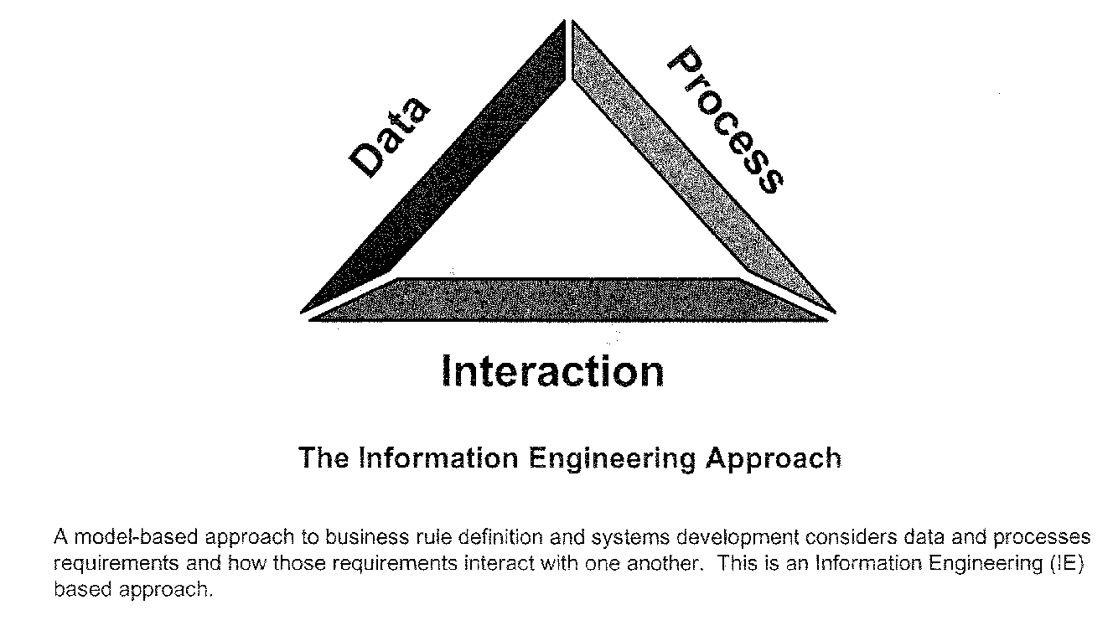
Context for Data Modeling

Slide 38

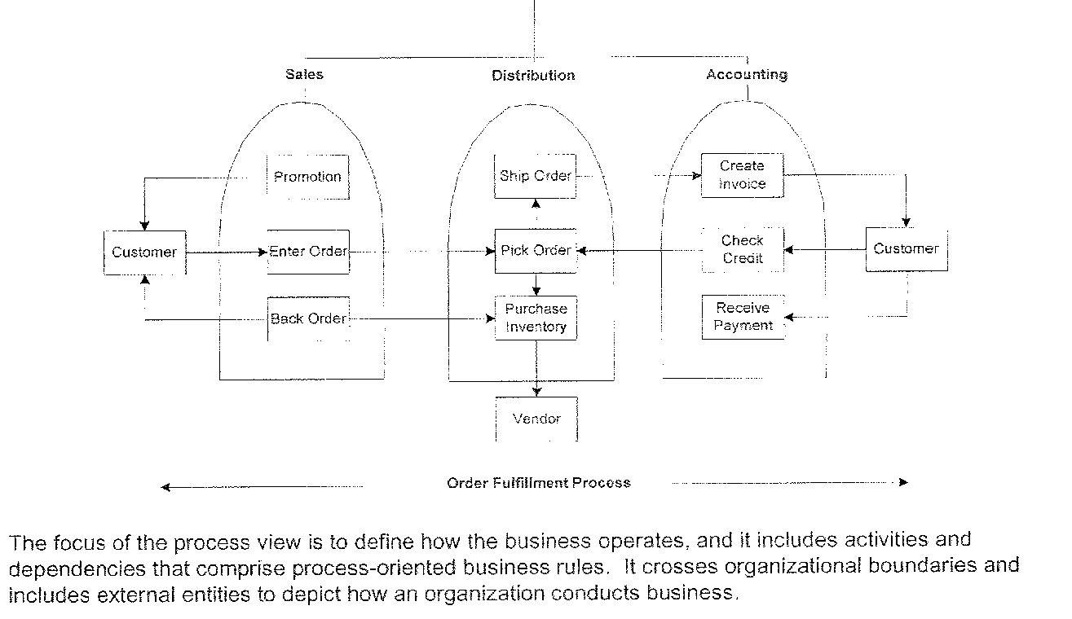
Business Enterprise - Process View

Slide 39
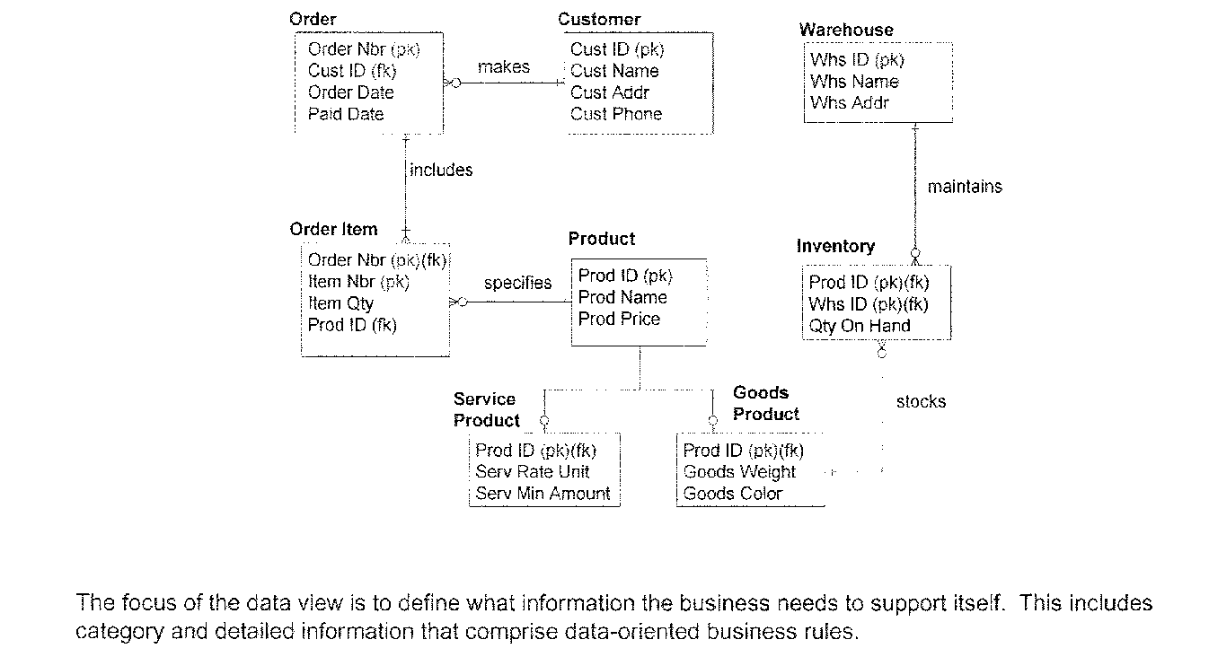
Business Enterprise – Data View

Slide 40
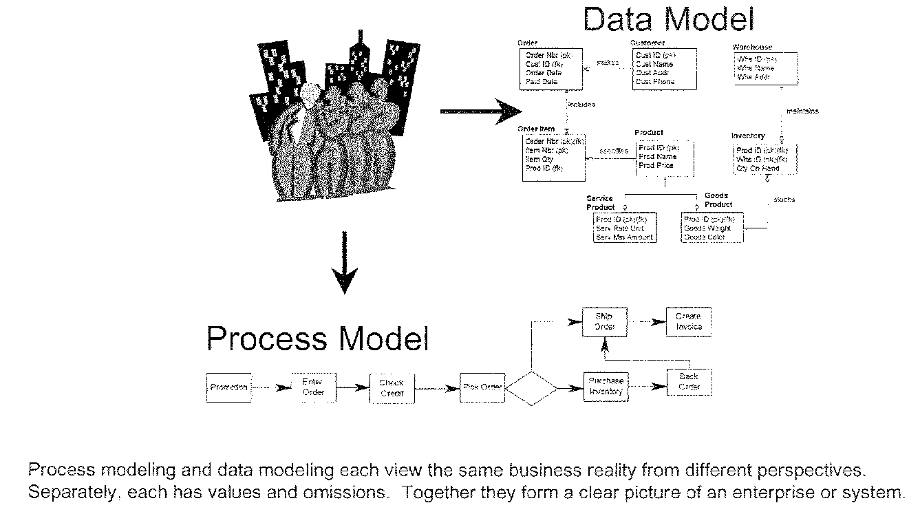
Business Enterprise Overview

Slide 41
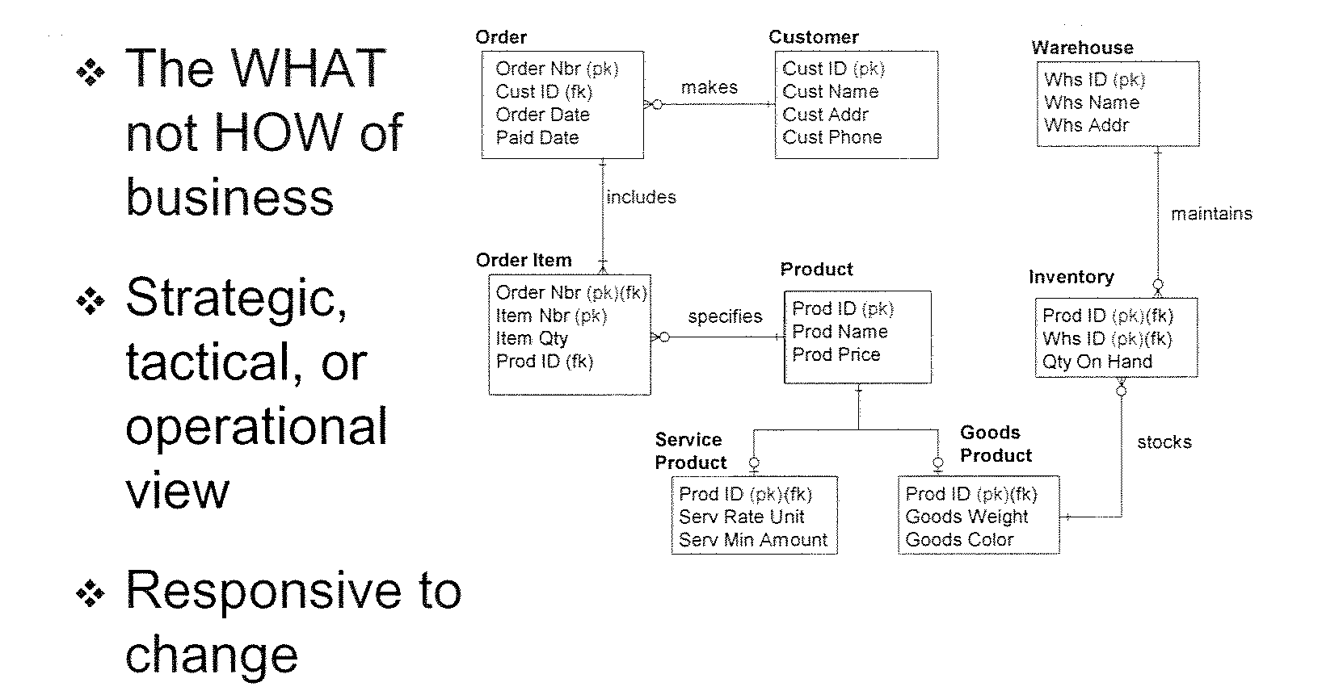
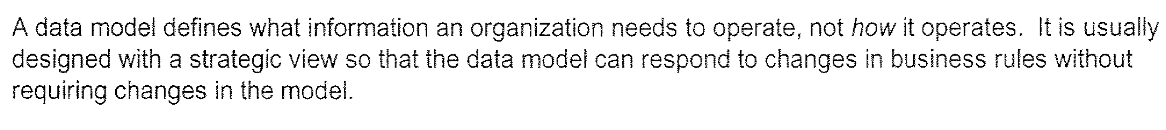
Data Model Overview – Role in Business

Slide 42
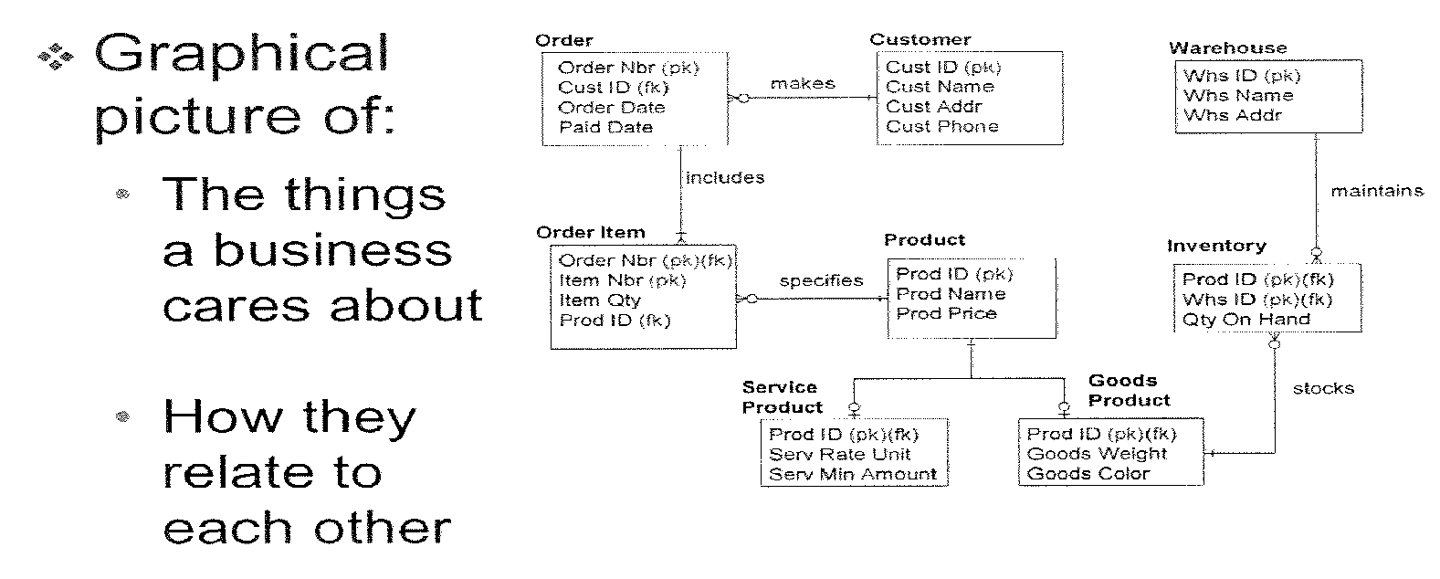
Data Model Overview - Characteristics

Slide 43
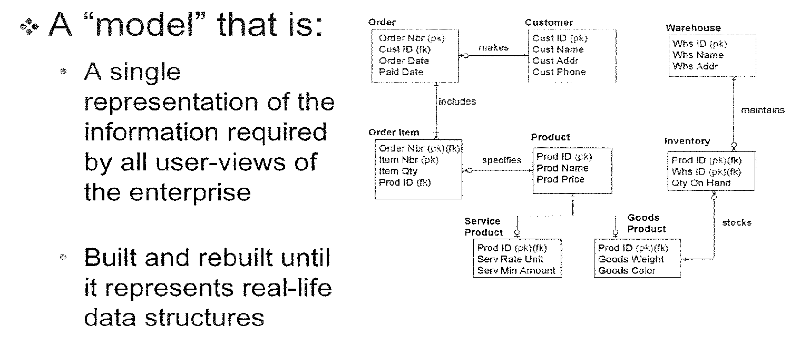
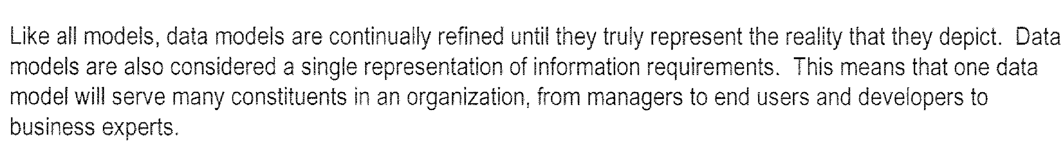
Data Model Overview – Characteristics Contd..

Slide 44
Data Modeling Overview

Slide 45
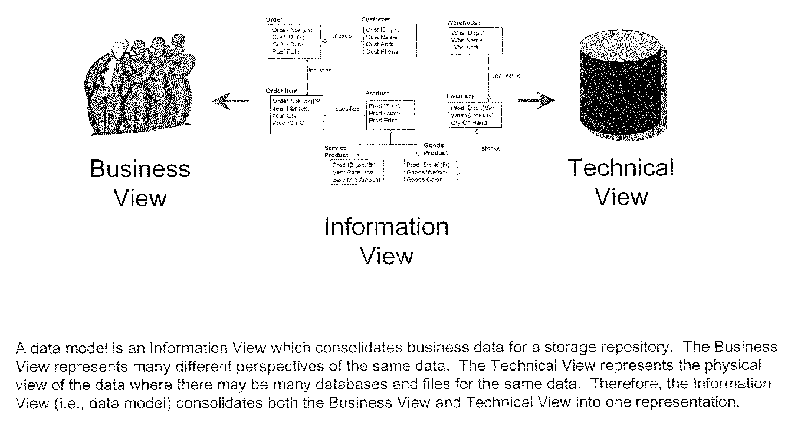
User Views
Notes:
Business View is a semantic layer.
Technical view is a Database schema.

Slide 46
Types of Data Models
Conceptual
Business Users
Logical
Designers
Physical
Implementers
Multiple levels of abstraction, ranging from very general to highly specific

Slide 47
Conceptual Data Model
A Conceptual data model is :
Semantic layer representing business view
High level model depicting core subject areas and key entities
in each subject area
Database and technology, organization independent

Slide 48
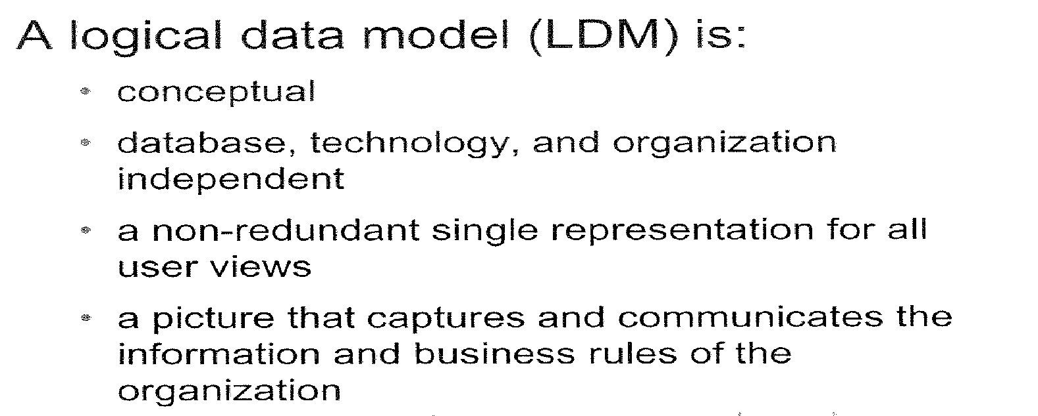
Logical Data Model

Slide 49
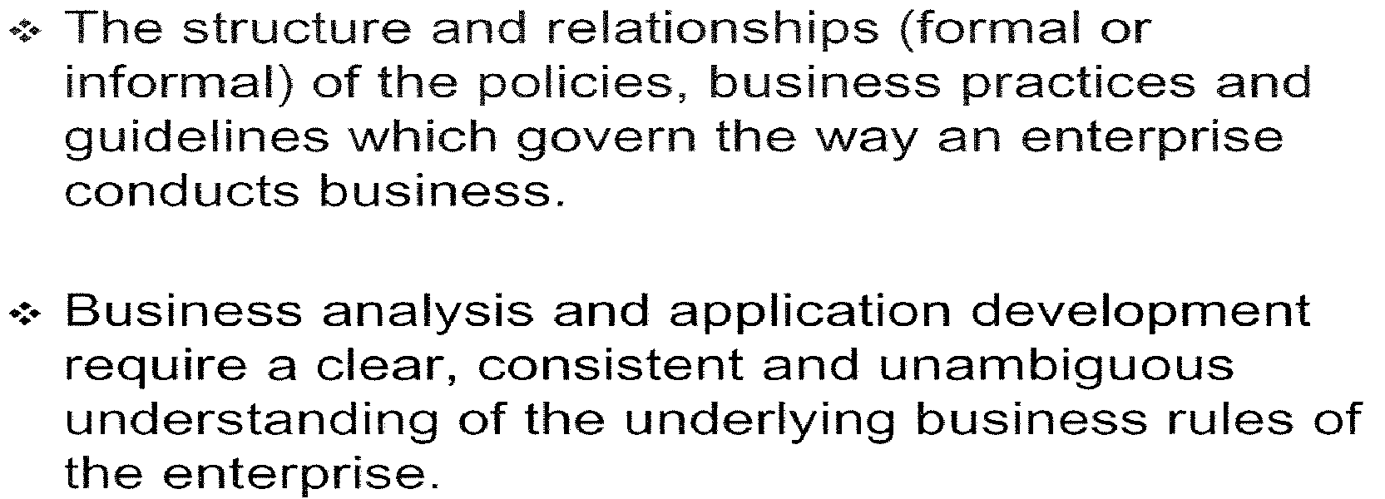

Defining Business Rule

Slide 50
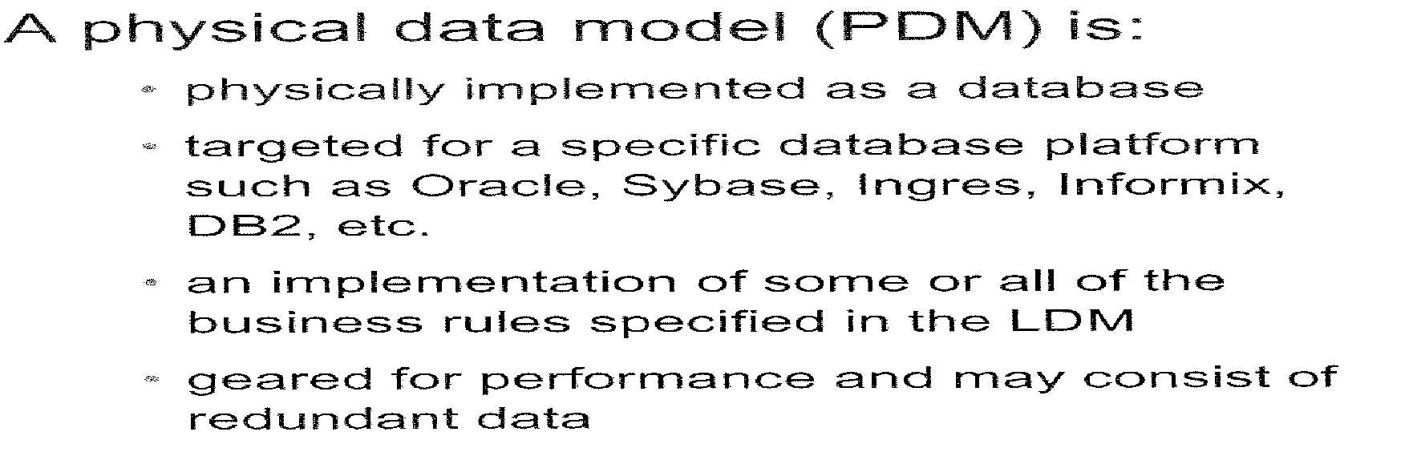
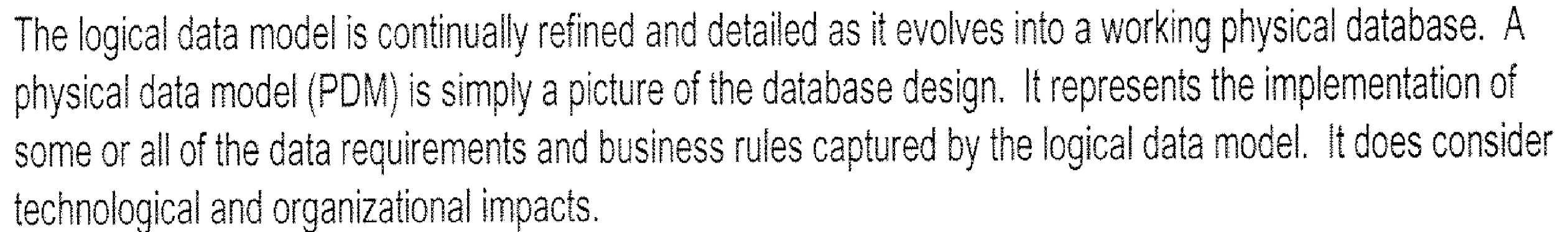
Physical Data Model

Slide 51
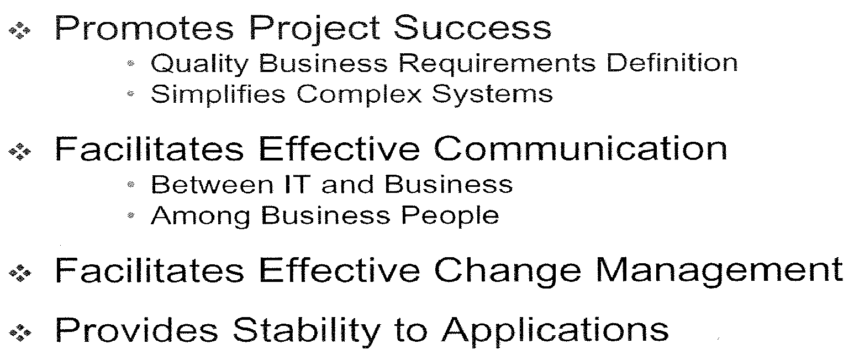
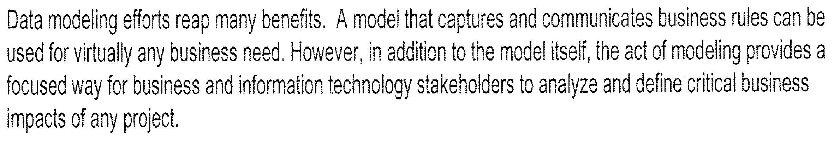
Data Model Benefits

Slide 52
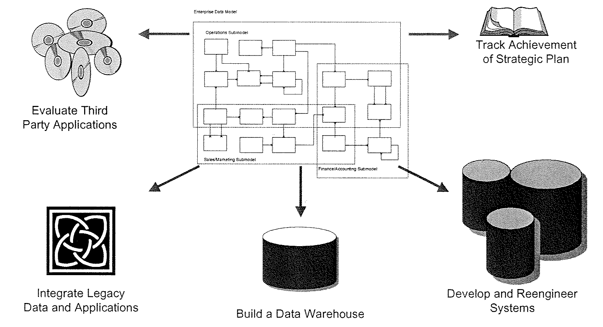
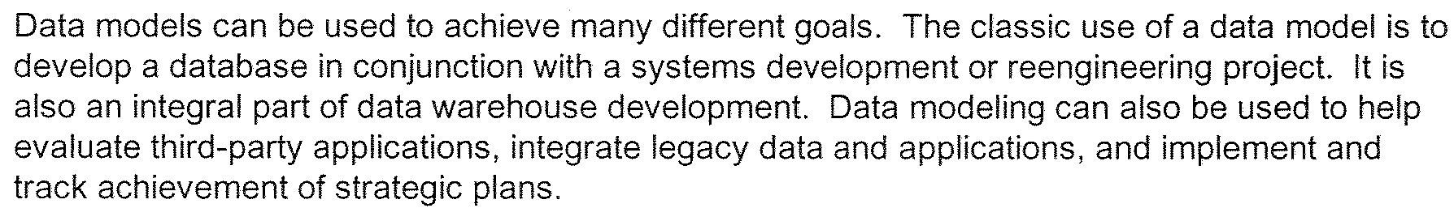
Uses of Data Model

Slide 53
Data Modeling – Terms & Concepts

Slide 54
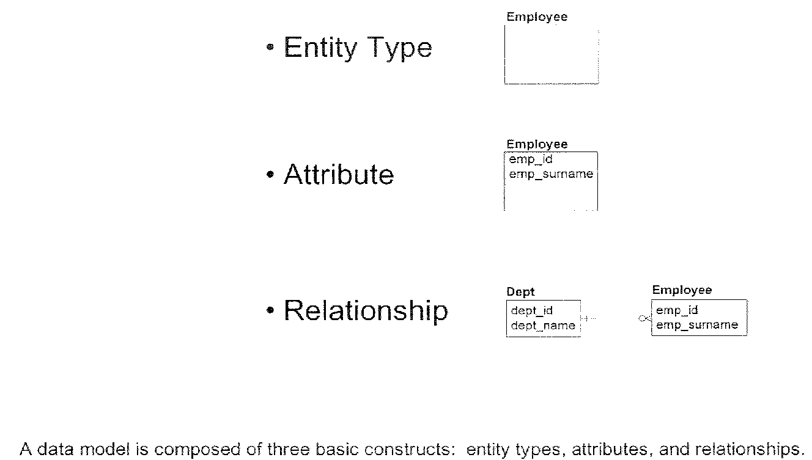
Basic Constructs

Slide 55
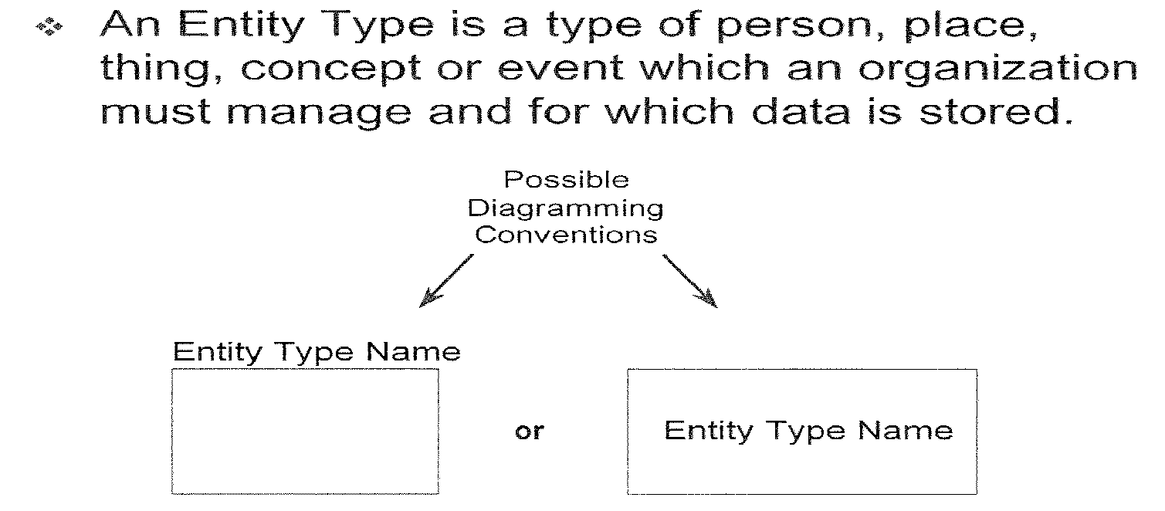
Entity Type

Slide 56
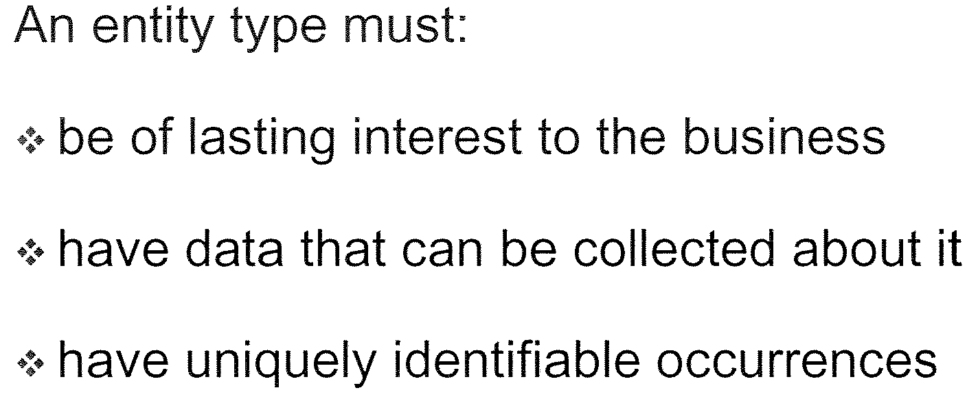
Rules for Entity Type Selection

Slide 57
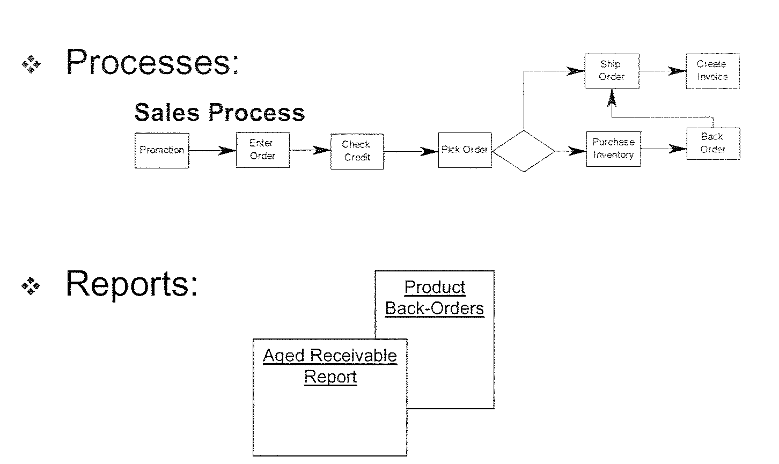
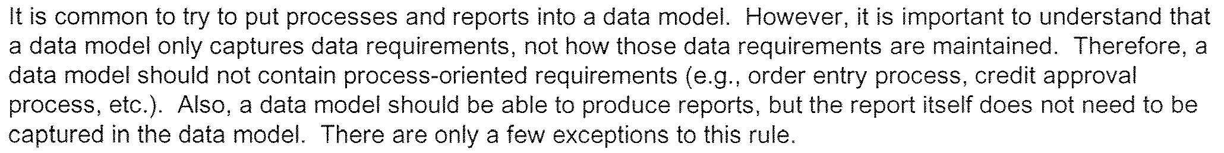
Common Mistakes in Entity Type Selection
Notes:
Few exceptions will be summary, flat tables designed for ease of querying and reporting.

Slide 58
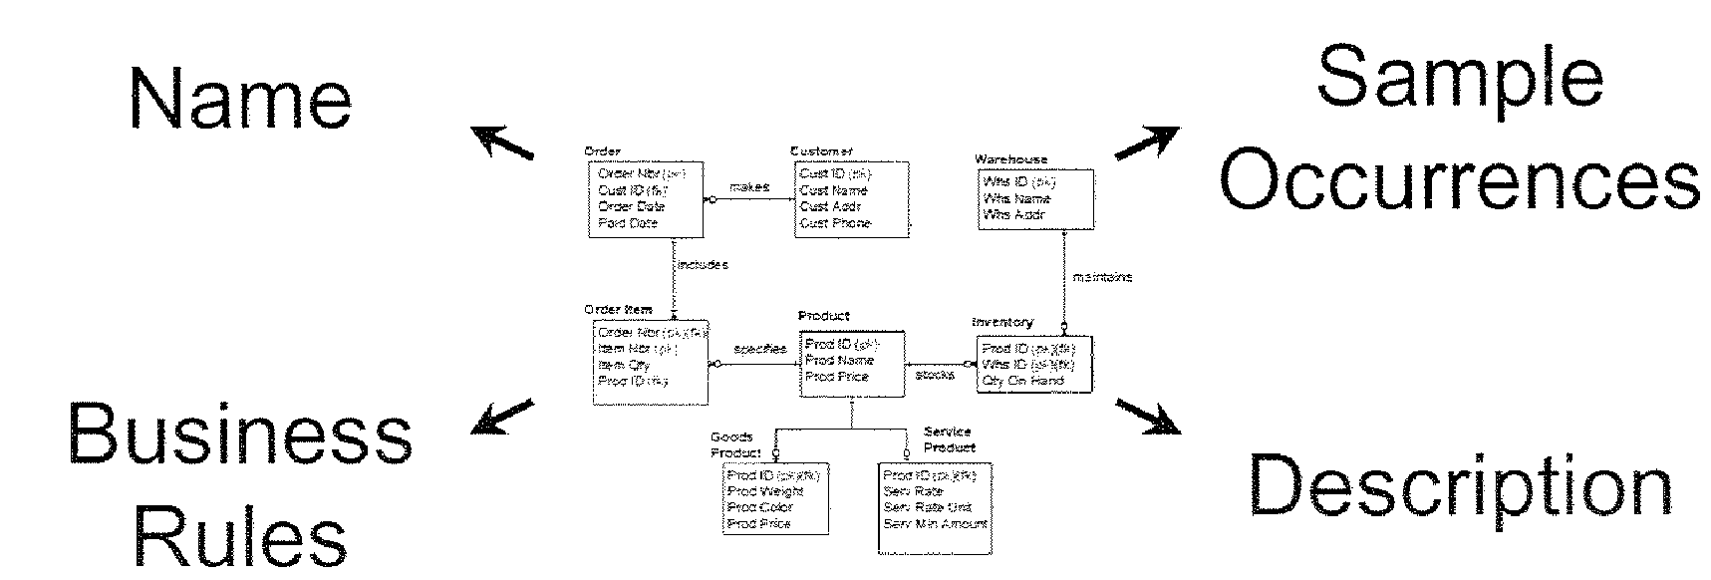
Business Metadata

Slide 59
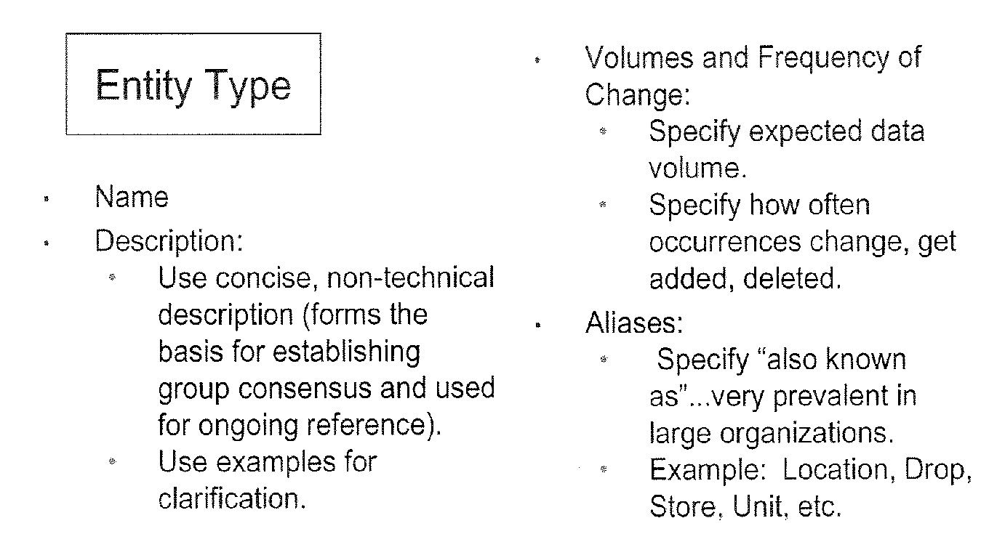
Metadata for Entity Type

Slide 60
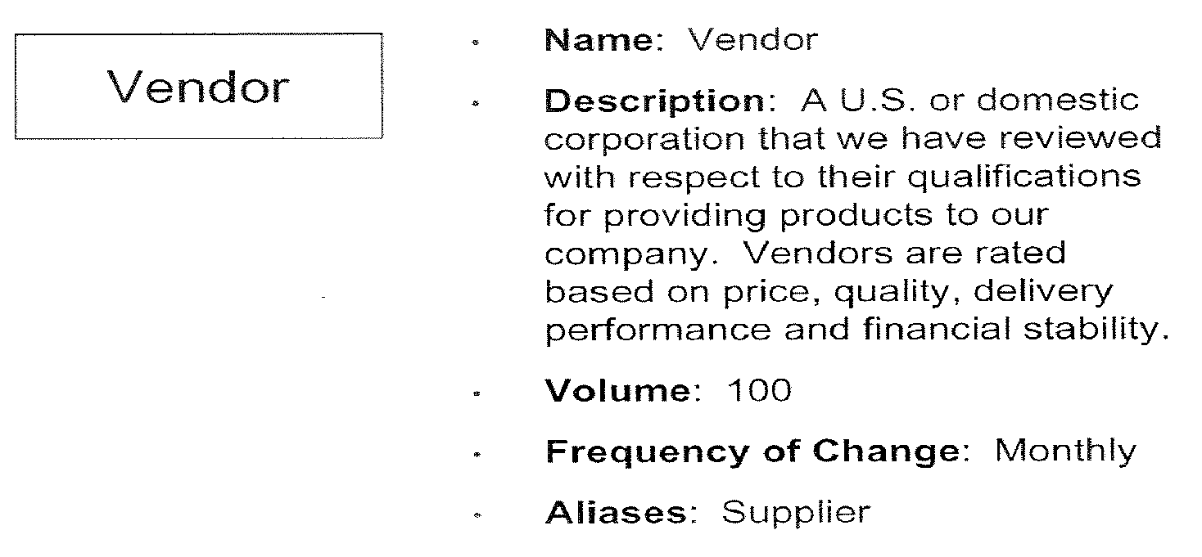
Entity Type Metadata Example

Slide 61
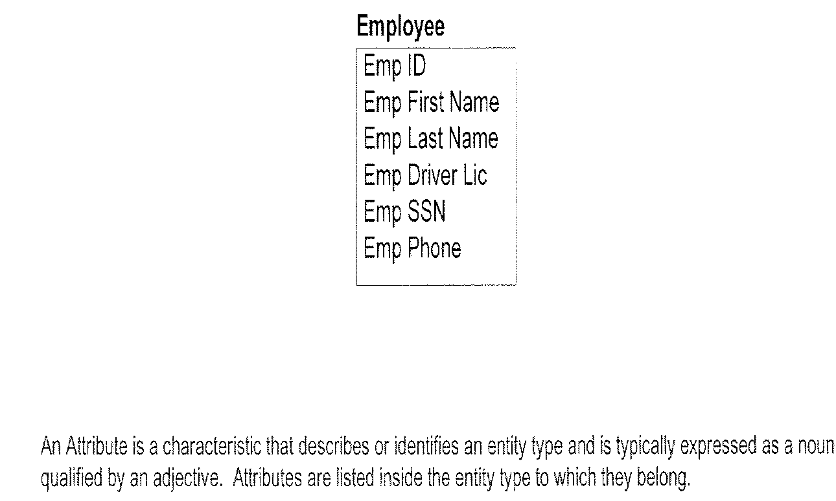
Attribute – Definition & Example

Slide 62
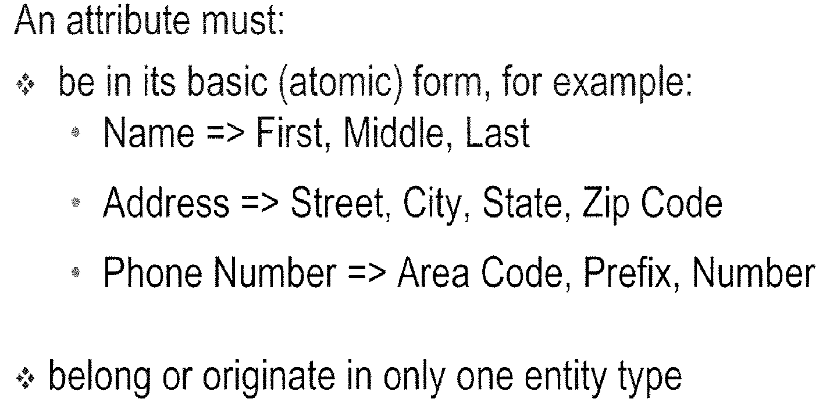
Attributes - Rules

Slide 63
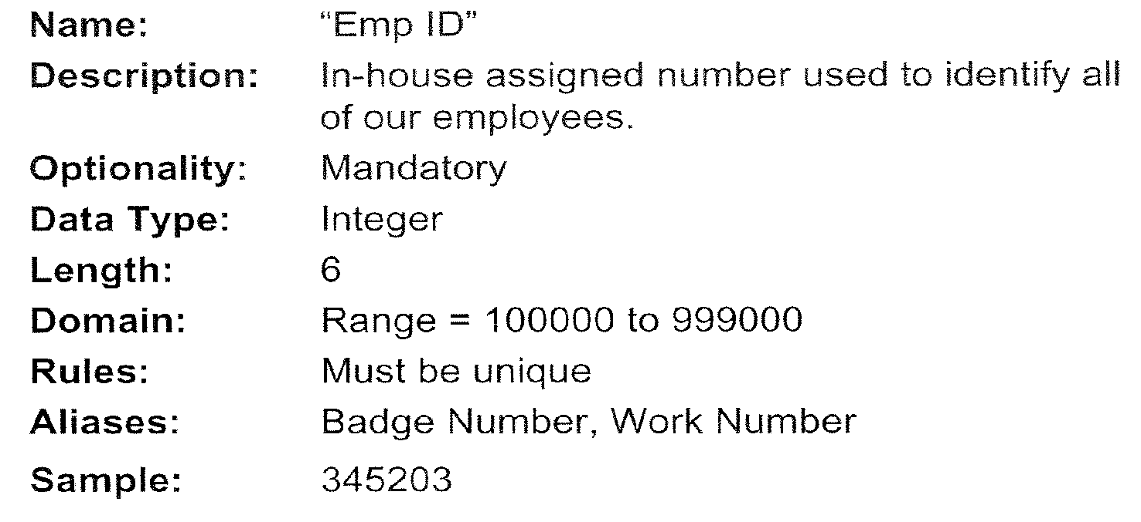
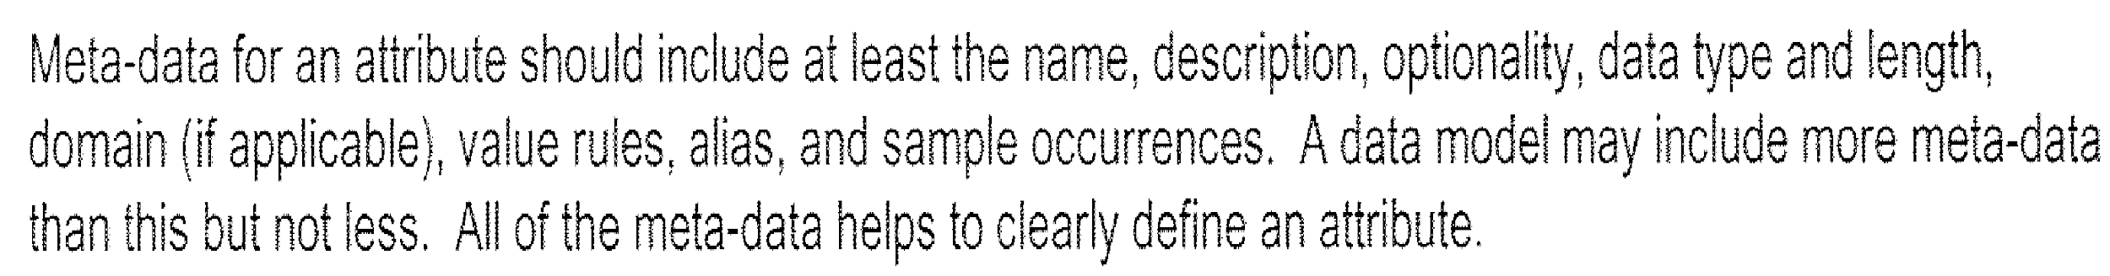
Attribute Metadata Example

Slide 64
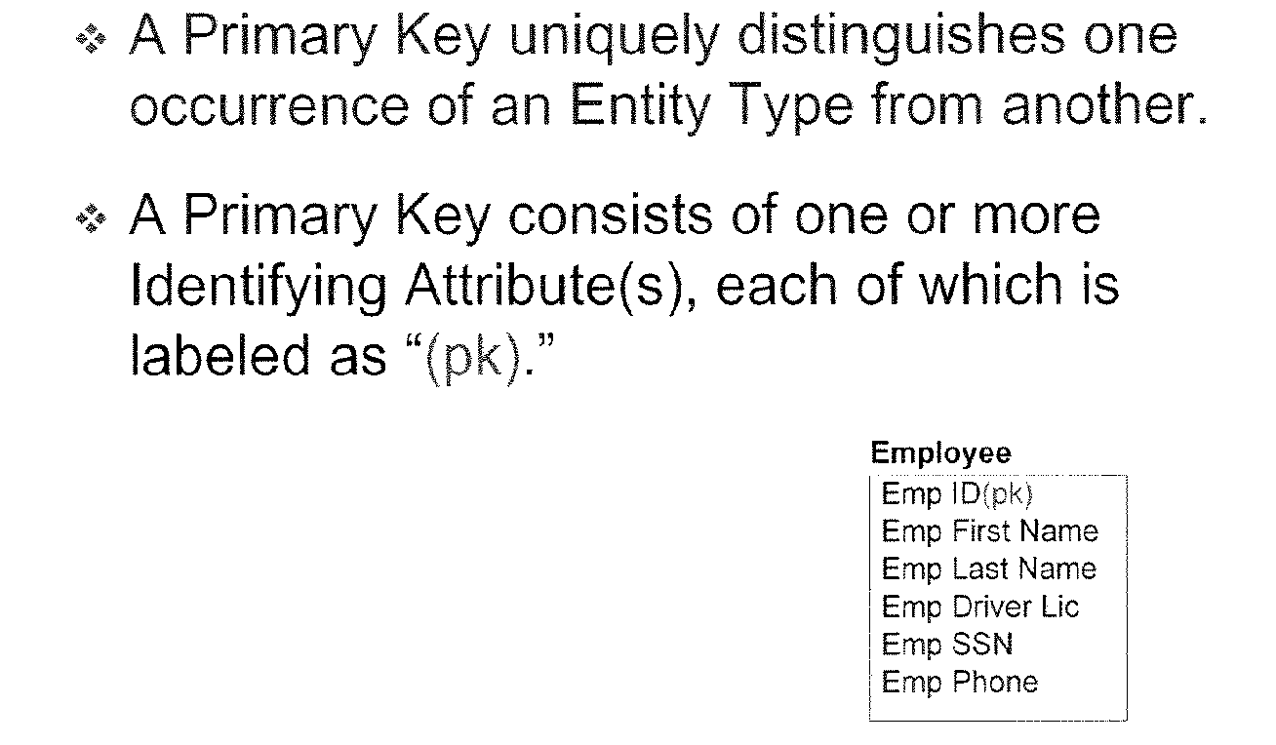
Primary Key

Slide 65
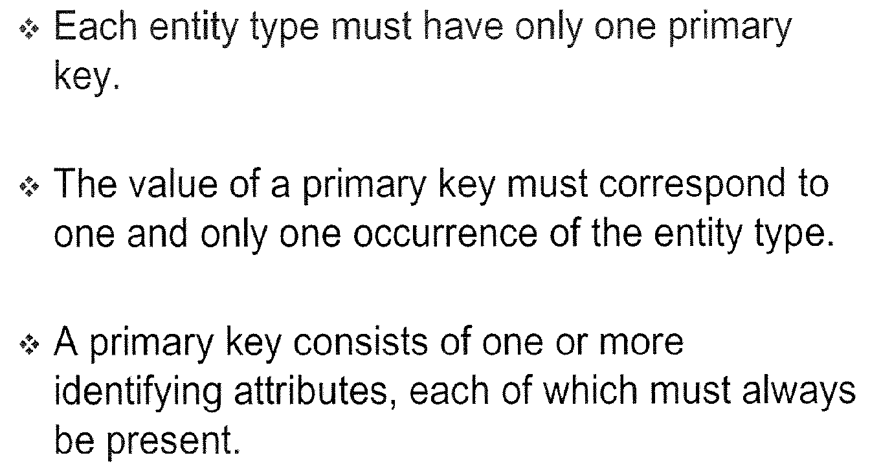
Rules for Primary Key

Slide 66
Primary Key – Logical Considerations

Slide 67
Smart Code – Definition & Example

Slide 68
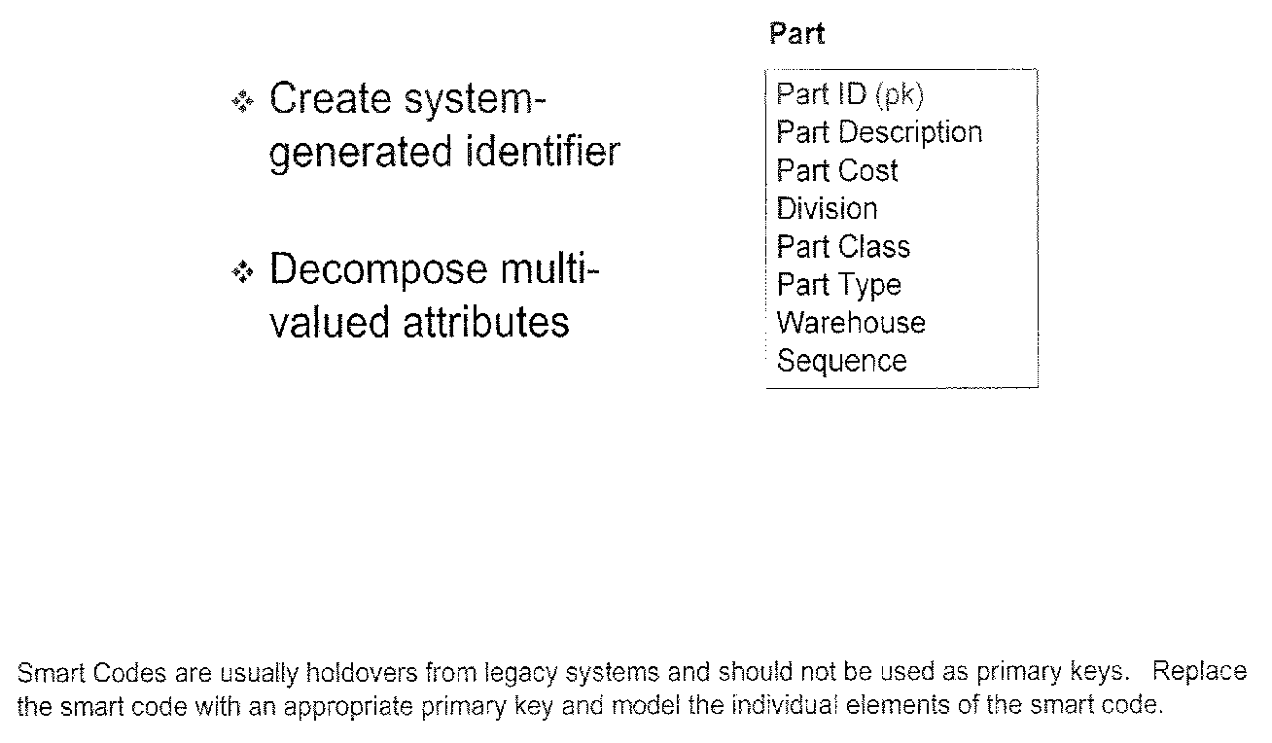
Smart Code - Resolution

Slide 69
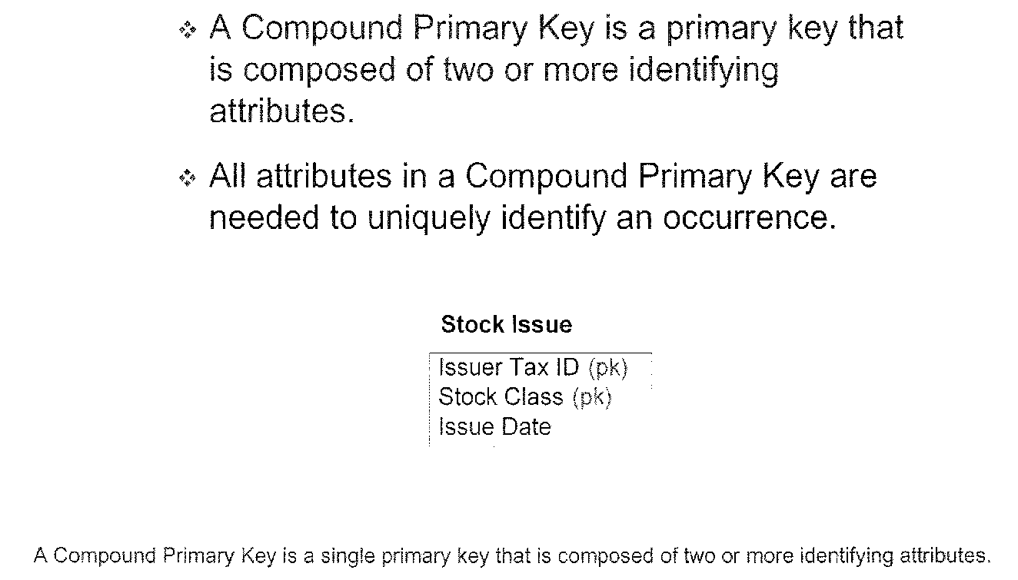
Compound Primary Key

Slide 70
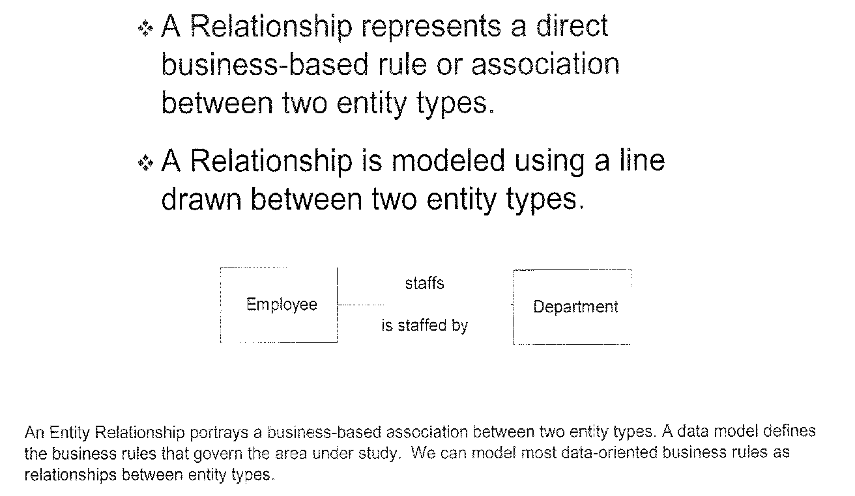
Relationship – Definition & Example

Slide 71
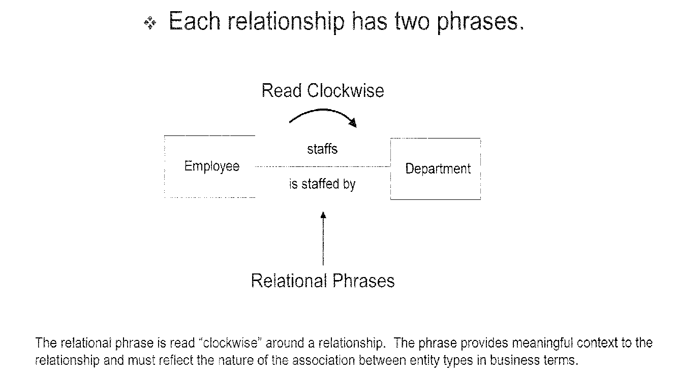
Relationship Phrase Example

Slide 72
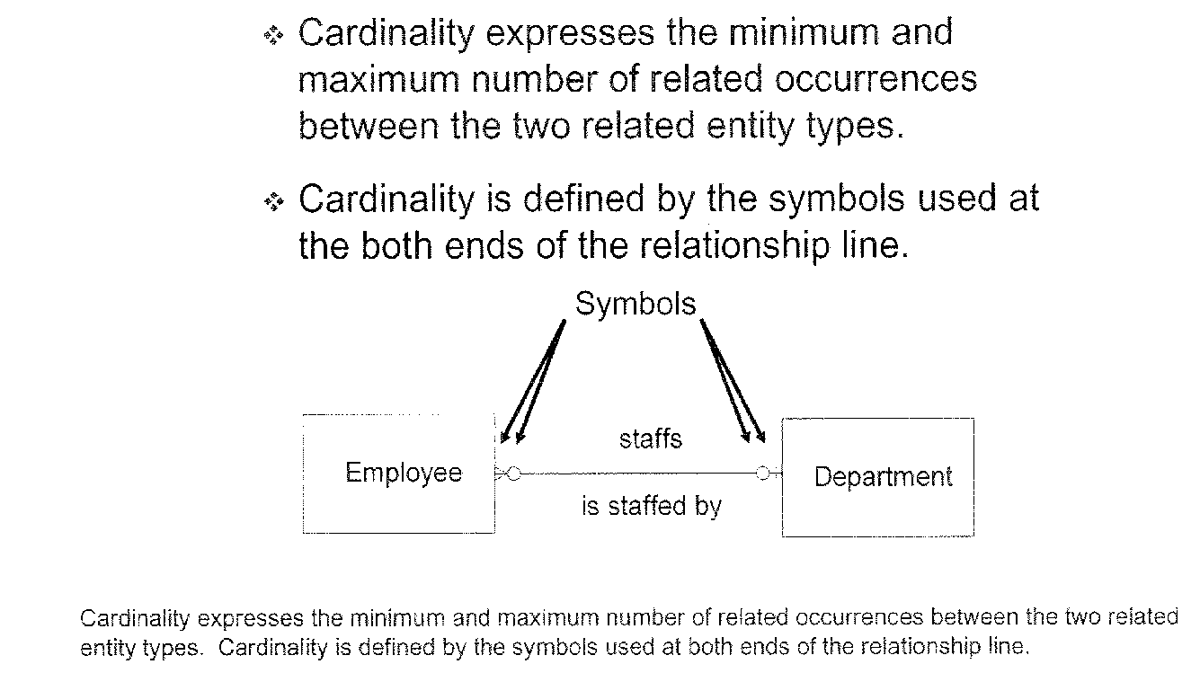
Relationship Cardinality

Slide 73
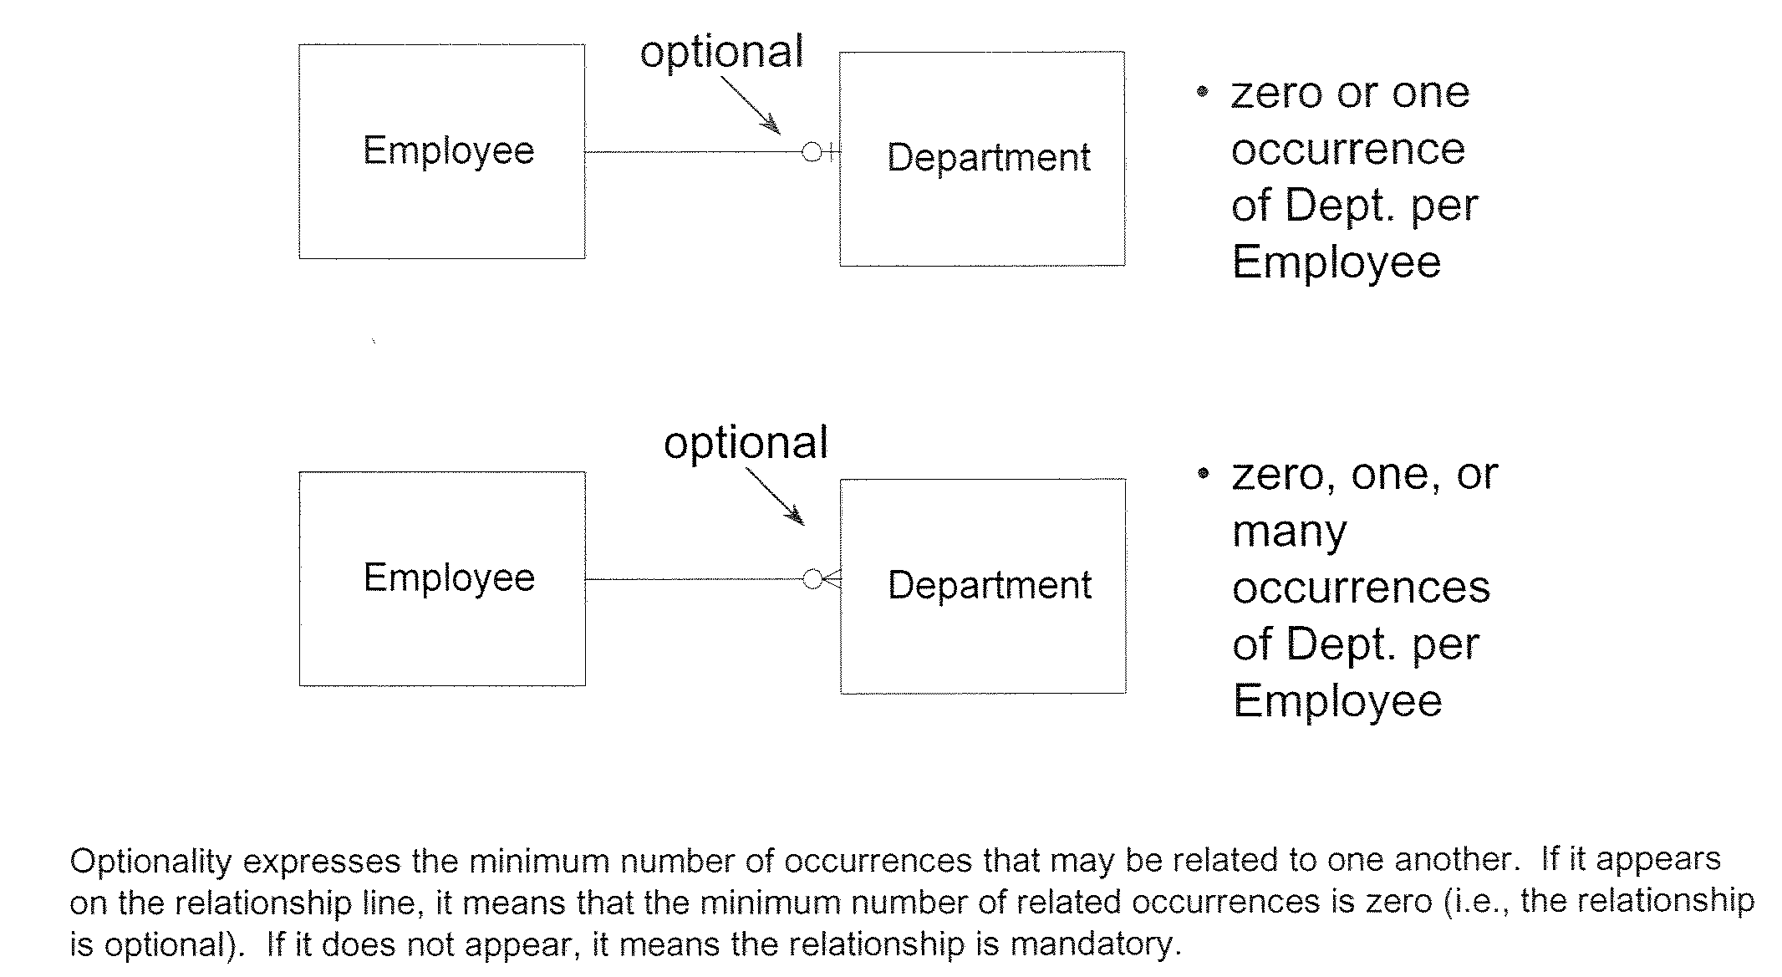
Relationship Optionality

Slide 74
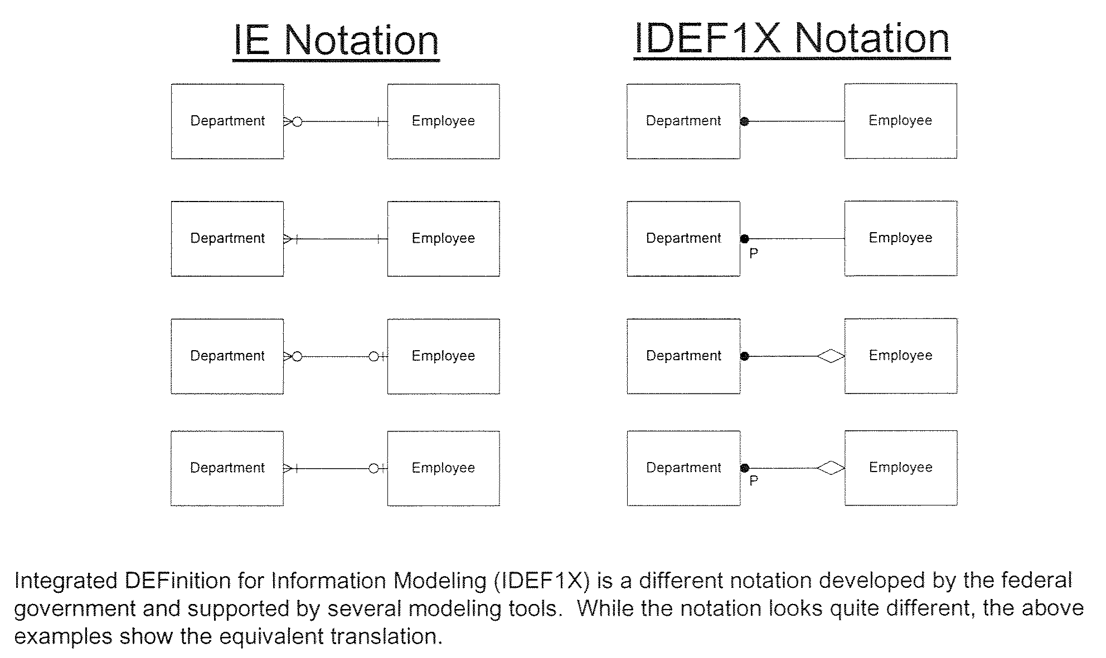
Relationship Notations – Information Engineering (IE) & IDEF1X

Slide 75
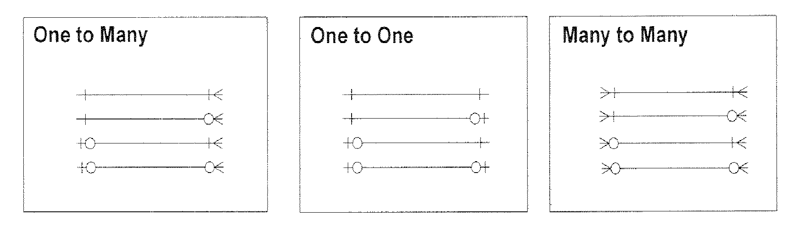
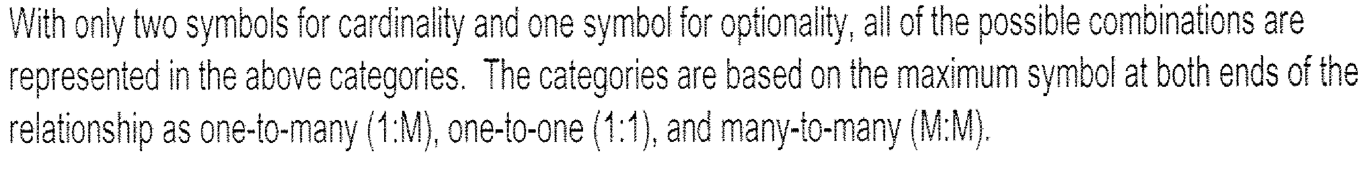
Relationship Types

Slide 76
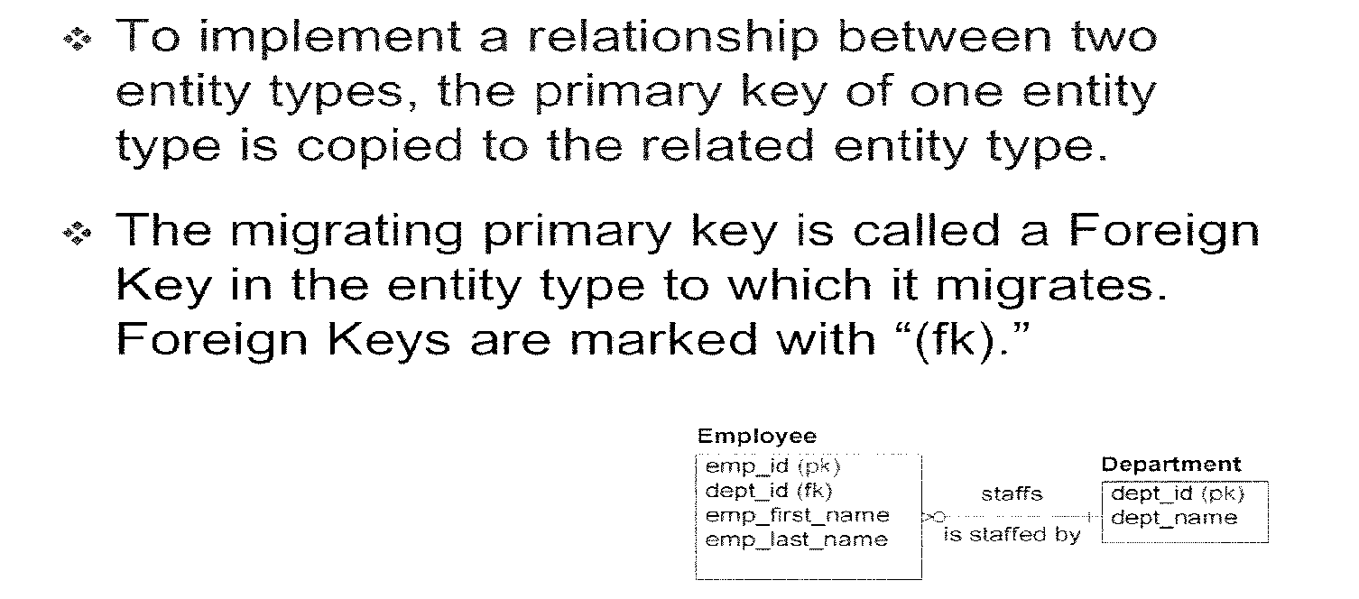
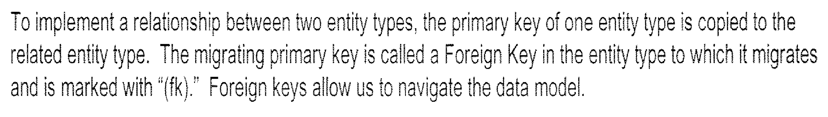
Foreign Key – Definition & Example

Slide 77
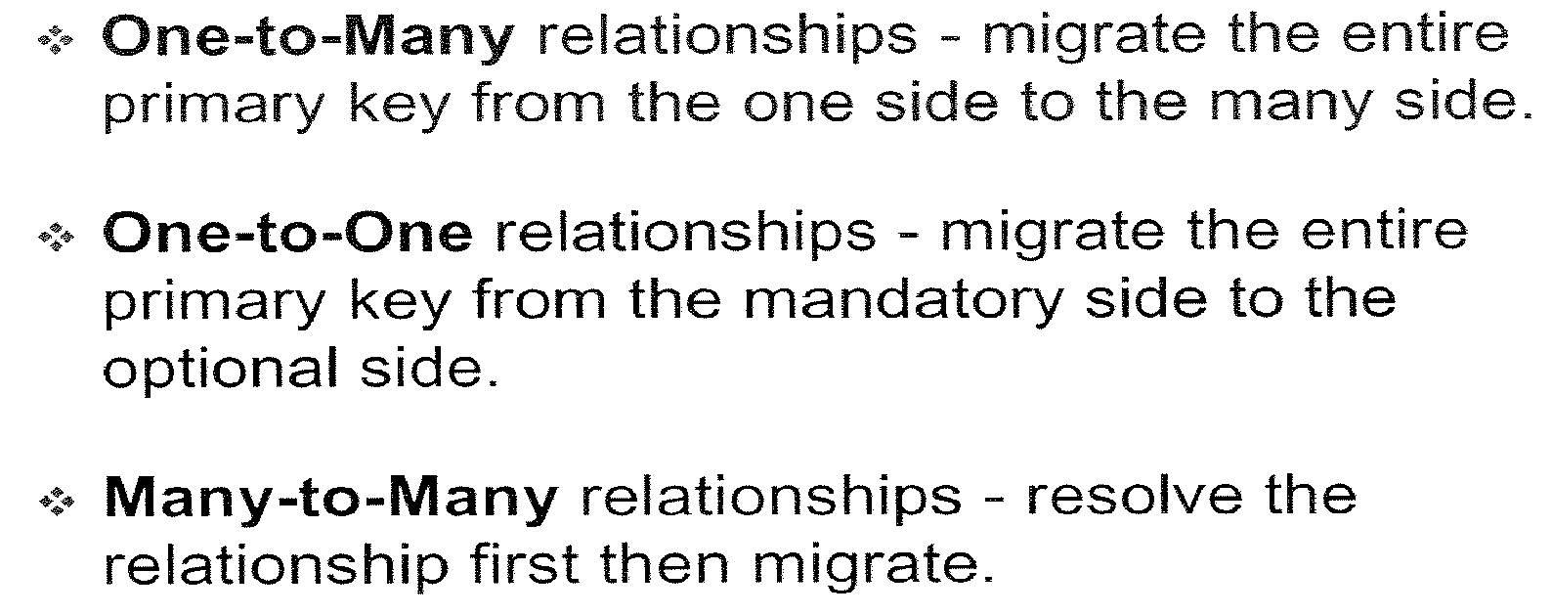
Foreign Key Rules

Slide 78
Data Modeling
in Data warehouse

Slide 79
Data Modeling In DWH Environment
A DWH Environment
Involves multiple (viz. source, staging & target) layers of data storages
Each layer has unique data modeling requirements
S1
Data Mart
Data
Warehouse
Staging
Olap
S2
Data Mart
S3
Reports

Slide 80
Data Modeling In DWH Environment
Data Modeling Approaches
Entity Relational Approach
Traditional modeling technique (more normalized)
Technique of choice for OLTP
Suits for corporate data Warehouse
Goals
Eliminate redundancy
Transaction efficiency
Dimensional Approach
Analyzing business measures in the specific business context (using STAR schema)
Helps visualize very abstract business questions
End users can easily understand and navigate the data structure
Goals
Query performance
Ease of understanding / use

Slide 81
References
Course structure was conceptualized from Business Data Modeling training course offered by Inteq Group (www.inteqgroup.com/bdm.aspx)
Wipro Data warehousing Training Material
www.agiledata.org
www.stevehoberman.com
www.inf.unibz.it/~franconi/teaching/2000/ct481/er-modelling
Fundamentals of Database Systems by Ramez Elmasri,
Shamkant Navathe, Publisher - Addison Wesley

Slide 82
DW 101 – ETL Concepts
eTPG (DW-BI) – BTS (FS &TMT)

Slide 83
Agenda
ETL Overview
Data Extraction Overview
Data Transformation Overview
Data Load Overview

Slide 84

ETL Definition
ETL -Extract, Transform and Load
ETL is the set of processes by which data is extracted from various sources,transformed and loaded into target systems

Slide 85
Importance of ETL
ETL technology is an important component of a complete enterprise data integration solution and the cornerstone of many strategic technology initiatives that benefit greatly from data profiling, data quality and metadata management functionality
Support data extraction, cleansing, aggregation, reorganization, transformation,
and load operations
Generate and maintain centralized metadata
Closely integrated with RDBMS’s
Filter data, convert codes, calculate derived values, map many source data fields
to one target data field
Automatic generation of data extract programs
High speed loading of target data warehouses
Employs Middle Ware for near Real Time ETL

Slide 86

ETL Framework

Slide 87
ETL Activities
Data Extraction:
Rummages through a file or
database
Uses some criteria for selection
Identifies qualified data and
Transports the data over onto
another file or database
Data Extraction – Cleanup
Restructuring of records or fields
Removal of Operational-only data
Supply of missing field values
Data Integrity checks
Data Consistency and Range checks, etc...
Data transformation
Integrating dissimilar data types
Changing codes
Adding a time attribute
Summarizing data
Calculating derived values
Renormalizing data
Data loading
Initial and incremental loading
Updation of metadata

Slide 88
Data Extraction Overview

Slide 89

Data Extraction Overview
Extraction is the operation of extracting data from one or more source systems for further use in a data warehouse environment.
This is the first step of the ETL process.
Data can be extracted to a file or table as required.
After the extraction, this data can be transformed and loaded into the data warehouse .
Internal Source Data: Extracted directly from the source system. Process can connect to the source system or to an intermediate system that stores the data in a preconfigured manner.
External Source Data: Not extracted directly from the source system.
Sample source systems:
Mainframe Sources
Flat files: Fixed length, Delimited
XML Sources
Web log sources
ERP System Sources
Notes:
The source systems for a data warehouse are typically transaction processing applications. For example, one of the source systems for a sales analysis data warehouse might be an order entry system that records all of the current order activities.
There are also external sources of data that need to be extracted and integrated. For example: Stock market Index data in the securities domain, A.C.Nielson’s Retail data or Partner’s data.
Depending on the chosen logical extraction method and the capabilities and restrictions on the source side, the extracted data can be physically extracted by two mechanisms. The data can either be extracted online from the source system or from an offline structure. Such an offline structure might already exist or it might be generated by an extraction routine.
Online Extraction: The intermediate system is not necessarily physically different from the source system With online extractions, you need to consider whether the distributed transactions are using original source objects or prepared source objects.
There are two kinds of Physical extraction:
Online Extraction :
The data is extracted directly from the source system itself.
The extraction process can connect to the source system or to an intermediate system that stores the data in a preconfigured manner (for example, snapshot logs or change tables).
Offline Extraction:
The data is not extracted directly from the source system.
Data is staged explicitly outside the original source system.
The data already has an existing structure or was created by an extraction routine. Consider the following structures:
Flat Files
Data in a defined, generic format. Additional information about the source object is necessary for further processing.
Oracle-specific format. Information about the containing objects is included.
Redo and Archive Logs

Slide 90
Data Extraction Methods
Full Extraction
Data is extracted completely from the source system
No need to keep track of changes to the data source
Initial Extraction
This will be the historical data staging extracts
Full Extraction from source
Static extracts from source table to staging tables using a tool or hand coding.
Incremental Extraction
Only Changed Data will be extracted.
Complex Process
Real Time Extraction
Captures event-driven data by online systems
The goal of real-time data extraction is to keep the warehouse refreshed, with minimal delay, as changes happen in the operational systems data.
Batch Extraction
A high-performance data extraction solution for extracting large volumes
It synchronizes data at a set time, perhaps once a day, or once a week
Examples:
Live queries on operational or mirrored data.(static /Full capture,batch)
Reading database table dump tapes.(Real-time) Incremental
Interpreting transaction logs.(Real -time) Incremental
Writing custom programs to extract data from legacy application files.(Real-time) Incremental
TimeStamp based (Batch) Full/Incremental
Triggered (Real-time) Incremental
File comparison of versions (Real time) Incremental
Notes:
Full Extraction: No need to keep track of changes to the data source since the last successful extraction. The source data will be provided as-is and no additional logical information is necessary on the source site.
Incremental Extraction : The change data information can be either provided by the source data itself like an application column, reflecting the last-changed timestamp or a change table where an appropriate additional mechanism keeps track of the changes besides the originating transactions.
Pros and Cons:
Incremental Extract Techniques:
Time-Stamp based: Good for periodic data but not for transient data. Very dependant on the source system’s methodology of storing transactions. Special process required in source to identify different stages of a transaction. Example for Order processing.
File Comparison: Requires keeping both before and after copies of the operational file. Most useful when operational system is file based. Requires not change to the source applications. Suitable for Legacy systems
Triggered: Change captured immediately on the occurance of an event in the operational environment. Moves responsibility of change capture to the DBMS. Not appropriate for files extraction. Performance concerns when percentage of changes is high.
Log: source DBMS logs used for capturing changes. Not suitable for files extract. Does not run on operational system, hence does not hinder performance. If logs are from transaction then both files based and DBMS based sources can be extracted.
Static Full Extracts: Operates directly on the operational data where it resides in a file form or in a database.
Some considerations for this extract are: the variety of sources that the data exists in- sequential of indexed files, hierarchical, relational or other databases. Also, to consider are the physical storage formats to handle. Example of typical sql query: select * from customer_file.
Full Extraction
The data is extracted completely from the source system.
No need to keep track of changes to the data source .
An example may be an export file of a distinct table or a remote SQL statement scanning the complete source table.
Incremental Extraction
Only the data that has changed since a well-defined event back in history will be extracted.
The event may be the last time of extraction or a more complex business event like the last booking day of a fiscal period.
This information can be either provided by the source data itself or a change table where an appropriate additional mechanism keeps track of the changes.
Batch Extraction:
It provides a high-performance data extraction solution for extracting and loading large volumes of data from any system.
It synchronizes data at a set time, perhaps once a day, or once a week. Or even monthly – and usually while production systems are either taken offline, or at least show minimal activity (middle of the night, weekends, etc.)
Two basic techniques for real-time Extraction:
Simulated real-time feed and Trickle feed based on message queues.
Simulated real time:
Run the ETL scripts frequently. For ex every 1 hour. Cost Effective solution.
Technique is not truly real time, but simulates the effect.
Good for cases that don't require up-to-the-minute information.
Trickle feed:
It allows continuous update of the DW as the data in the source system changes.
Uses a messaging infrastructure setup between the data sources and the real-time warehouse.
It is called "streaming" and is a form of data replication strategy.
Real Time Extraction :This may sound simple but complex architectural issues need to be considered carefully.
The first is how the system identifies what data has been added or changed since the last extract. This is called changed data, or the "delta." Identifying the delta is simple if source transactions record a timestamp. If not, the job becomes more complex and difficult; you need special push-pull mechanisms, such as a message queue, database triggers, or streams.
The second issue is the performance impact of real-time extracts on the source system. Source systems are mostly transactional and mission critical; extracts clearly should not damage their performance. Finally, as the data is continuously loaded into the RTDW, key user perception issues, including how data is aggregated, must be managed carefully.
There are two basic techniques for real-time Extraction: simulated real-time feed and trickle feed based on message queues. The choice of technique depends on the architecture, platforms, and performance requirements.
Simulated real time. The ETL objects in a traditional, batch-oriented data warehouse typically run either daily or weekly. To evolve to a RTDW, a simple and cost-effective technique is to increase the frequency of these batch runs to hourly or even more frequently by scheduling the extraction scripts accordingly. This technique is not truly real time, but simulates the effect and may be good enough for cases that don't require up-to-the-minute information. This technique requires minimal changes to existing ETL infrastructure and therefore is easy to implement.
Trickle feed. Trickle-feed techniques allow continuous update of the RTDW as the data in the source system changes. These techniques use a messaging infrastructure setup between the data sources and the real-time warehouse. A data pipe is set up between the source and the target and is perpetually open. This technique is also called "streaming" and is a form of data replication strategy.

Slide 91
Real time Vs Batch
Batch
Real Time
Pros
Quick and relatively easy to write scripts for doing exports and imports.
Does not usually require additional hardware.
Almost all applications provide utilities for exporting and importing.
Event driven, allowing for unified applications that support a business process that fits how people really want to work.
Systems can interact in a transactional manner, providing true synergy.
Cons
Not event driven--does not facilitate notification or change in another application at the time of a change in first application.
Business processes that span applications are clumsy and do not behave as one.
Usually requires additional hardware, software, and expertise.
Some applications do not provide APIs or interfaces needed for real-time integration.
Expensive.

Slide 92
Extraction To-Do List
Following steps should be complete before starting any physical ETL development
Logical data map provided by DW architect-describes the process end to end.
Identify data source candidates
Analyze source systems with a a data-profiling tool
Data discovery
Anomaly detection
Receive walk-through of logical plan and business rules
Business rules defined at the data modeling stage are different from those required by the ETL team.
Receive walk-through of data warehouse data model
Validate calculations and formulas.
Notes:
Detail logical data map
Add spreadsheet to show example
Data Discovery:
Source system tracking report
-serves as outline for future phases of the DW.
-Determine system of record – the originating source of data. The further downstream you go from the originating data source, the more you increase the risk of extracting corrupt data.
-dealing with derived data (precalculated data)- can get base elements and calculate but has to match with source system. If source system logic changes ETL has to be modified.
Analyzing source sytems-data profiling:
-Identify when tables are related to each other, which columns have dependencies across tables.
-Ability to navigate an ER diagram is essential to performing data analysis.

Slide 93
Comparison of ETL tool – Data Extraction
Feature
Informatica PowerCenter
Ascential Data Stage XE
Ab Initio
Multiple Sources
For Extraction: DB/2, DB/2 /400,Flat Files, IMS, Informix, MS SQL Server, MS Access, Oracle, Sybase, UDB, VSAM, ODBC, Others.
QSAM: Sequential flat files ISAM: VSAM: KSDS, RSDS, ESDS - support GROUPS, multi-level arrays, REDEFINES, and all PICTURE clauses. DB2, Adabas, Oracle OCI ( For releases 7 and 8 ) , Sybase Open Client , Informix CLI , OLE/DB for Microsoft SQL Server 7, ODBC.
Oracle, TeraData, DB2, Informix, SQL Server, XML files, Sybase, Flat Files, VSAM Cobol Files and others. Flat files can be imported as Target using Data set component.
Types of Extracts supported
Incremental loads, Event driven loads, Entire copy of source table (refresh) is supported within PowerCenter .
Following extract methods are possible
Incremental
Transaction Event
Full
Ascential also provides Change Data capture for popular RDBMS.
Code Generation
PowerCenter does not generate code,all the mappings developed will be inform of GUI interface.
Only Datastage XE/390 version automatically generates and optimizes native COBOL code and JCL scripts that run on the OS/390 mainframe.
It has GUI interface and also generates code of scripts using mp, which is shell based development environment for implementing applications using Ab initio
Real-Time Data Integration
Provides Real Time features using PowerCenter RT and EAI tools
Supports real time integration. DataStage can operate in real-time, capturing messages or extracting data at a moment's notice on the same platform that also integrates bulk data.
Has a product called Continuous Flows to implement real-time data access.
Change-Data-Capture Feature
No inbuilt feature to capture the changed records in the source systems. However this can be handled using custom code in the source qualifier. If the source is SAP then using IDOC's feature of the SAP it is possible to capture the changed records.
Ascential provides a number of ways to capture changed data.
Ab Initio supports a wide variety of change data capture strategies.
Notes:
ERP Sources: Data Stage
DataStage XE provides full integration with leading enterprise applications including SAP, Siebel, and PeopleSoft. The DataStage Extract PACKs for SAP R/3, Siebel and PeopleSoft, and the DataStage Load PACK for SAP BW enable warehouse developers to integrate this data with the organization's other data sources.
Types of extracts: Informatica
Incremental loads are supported using PowerCenter mapping variables and parameters.
Event driven loads are also supported within PowerCenter either using mapping variable/parameter files or using the event driven option in the scheduler. Once an event is recognized the during a mapping flow the type of load (new, update or delete) can be determined and then an update strategy transformation object is used to apply this
Entire copy of source table (refresh) is supported within PowerCenter
Code Generation – Ab initio
It has GUI interface and also generates code of scripts using mp, which is shell based development environment for implementing applications using Ab initio s/w. This is on Unix Environment. This mp acts as an intermediate language and as the language in which the applns are deployed. We can include user- defined scripts at the beginning and end of Ab initio codes.
Ascential provides a number of ways to capture changed data. If the source has an effective date in the database tables, then “Net Change” processing can be used. Save the date and time of the last time the job was run and input it as a parameter for the next run. Use the parameter to filter the records in a where clause to only get the new or changed records since the last processing date. This can be set up to automatically run. Most ERP systems have a change date. The Ascential Packs for ERP allow a delta file to be created.
Ab Initio supports a wide variety of change data capture strategies. They range from using Ab Initio
to discover changed data, to integrating third-party products that specialize at this task. Ab Initio can be easily integrated with third-party log sniffers, such as products from BMC or other vendors of the user’s choice.

Slide 94
Data Transformation Overview

Slide 95

Data Transformation Activities
Integrating dissimilar data types (Lookups & Joins)
Changing codes
Adding a time attribute
Summarizing data( Aggregation)
Calculating derived values
Renormalizing data

Slide 96
Aggregation Techniques
Aggregation is a process in which information is gathered and expressed in a summary form, for analysis.
Aggregates are used for two primary reasons
To save storage space
To improve the performance of business intelligence tools
Notes:
Aggregation :
Aggregation refers to the gathering of information in separate sets from two or more sources. Often, this data is stored in a data warehouse in a summarized form. For example, an organization may wish to summarize the data by various time periods. Aggregates are used for two primary reasons. One is to save storage space; data warehouses can get very large, and the use of aggregates greatly reduces the
space needed to store data. The second reason is to improve the performance of business intelligence tools. When queries run faster, they take up less processing time and the users get their information back much more quickly.
However, there is also a negative side to data aggregation. The process can result in the loss of time sensitive linear data. If a business is trying to compile a complete customer profile in order to understand its customers, aggregation is not beneficial.
Some data warehouses store both detailed information and aggregated information. This approach may take up even more space, but gives users the possibility of looking at all details while still having good query performance when looking at summaries. As well, user exit support exists today in some software that facilitates aggregation while also providing the ability to create a complete customer profile.
Data aggregation is any process in which information is gathered and expressed in a summary form, for purposes such as statistical analysis. A common aggregation purpose is to get more information about particular groups based on specific variables such as age, profession, or income. The information about such groups can then be used for Web site personalization to choose content and advertising likely to appeal to an individual belonging to one or more groups for which data has been collected. For example, a site that sells music CDs might advertise certain CDs based on the age of the user and the data aggregate for their age group. Online analytic processing (OLAP) is a simple type of data aggregation in which the marketer uses an online reporting mechanism to process the information.
Data aggregation can be user-based: personal data aggregation services offer the user a single point for collection of their personal information from other Web sites. The customer uses a single master personal identification number (PIN) to give them access to their various accounts (such as those for financial institutions, airlines, book and music clubs, and so on). Performing this type of data aggregation is sometimes referred to as "screen scraping."

Slide 97
Comparison of ETL tool – Data Transformation
Feature
Informatica PowerCenter
Ascential Data Stage XE
Ab Initio
Data Profiling Capability
PowerCenter 7’s native data profiling can run in batch or interactive mode, and uses either predefined or customized sets of rules to analyze the data without having to extract it first.
ProfileStage provides data profiling capabilities.
NA
Code Re-usability
Good features to make the code re-useable. Supported through re-useable transformations, Mapplets and also some extent short cuts.
Code Reusability is supported. Ascential's Quality Manager provides a framework for developing a self-contained and reusable Project which consists of business rules, analysis results, measurements, history and reports about a particular source or target environment.
Transformations can be shared
Handling duplicate records
This needs to be handled by using Aggregator Transform in the Mapping.
It can match and deduplicate records character by character exactly or match and deduplicate even non-exact record matches (and provide a probable likelihood that two records match), in the absence of common keys.
Ab Initio provides fundamental building blocks for implementing de-duplication
Notes:
ERP Sources: Data Stage
DataStage XE provides full integration with leading enterprise applications including SAP, Siebel, and PeopleSoft. The DataStage Extract PACKs for SAP R/3, Siebel and PeopleSoft, and the DataStage Load PACK for SAP BW enable warehouse developers to integrate this data with the organization's other data sources.
Types of extracts: Informatica
Incremental loads are supported using PowerCenter mapping variables and parameters.
Event driven loads are also supported within PowerCenter either using mapping variable/parameter files or using the event driven option in the scheduler. Once an event is recognized the during a mapping flow the type of load (new, update or delete) can be determined and then an update strategy transformation object is used to apply this
Entire copy of source table (refresh) is supported within PowerCenter
Code Generation – Ab initio
It has GUI interface and also generates code of scripts using mp, which is shell based development environment for implementing applications using Ab initio s/w. This is on Unix Environment. This mp acts as an intermediate language and as the language in which the applns are deployed. We can include user- defined scripts at the beginning and end of Ab initio codes.
Ascential provides a number of ways to capture changed data. If the source has an effective date in the database tables, then “Net Change” processing can be used. Save the date and time of the last time the job was run and input it as a parameter for the next run. Use the parameter to filter the records in a where clause to only get the new or changed records since the last processing date. This can be set up to automatically run. Most ERP systems have a change date. The Ascential Packs for ERP allow a delta file to be created.
Ab Initio supports a wide variety of change data capture strategies. They range from using Ab Initio
to discover changed data, to integrating third-party products that specialize at this task. Ab Initio can be easily integrated with third-party log sniffers, such as products from BMC or other vendors of the user’s choice.

Slide 98
Data Loading Overview

Slide 99

Initial Load
First load into the Data warehouse
Very similar to a system conversion process
Load the Live Operational Data
Notes:
The Initial Load
The process of preparing the initial load programs is very similar to a system conversion process, such as the one many organizations performed when they moved their old operational systems to an enterprise resource planning (ERP) product. In general, the first task of a system conversion process is to map selected data elements from the source files or source databases to the most appropriate data elements in the target files or target databases. The second task of a system conversion process is to write the conversion (transformation) programs to transform the source data. These conversion programs must also resolve duplicate records, match the primary keys, and truncate or enlarge the size of the data elements.
Typically missing from traditional conversion programs, and unfortunately, also missing from many ETL processes for BI applications, are data cleansing and reconciliation logic. Organizations repeatedly miss prime opportunities to bring order to their data chaos when they continue to “suck and plunk” the data from source to target as-is. Their only concern is that the receiving database structure does not reject the source data for technical reasons, such as duplicate keys, or data type and length violations. That is not good enough for BI applications because business people expect data quality and data consistency, which means that data must also be transformed for business reasons. We will come back to this topic in the next two issues when we discuss the design considerations for the ETL programs and the ETL process flow.

Slide 100
Historical Load
Extension of the initial load process
Loading the historical data (static data)
Format of Archived data different from operational data
Different set of conversion scripts needed
Lengthy and Complex process
Notes:
The Historical Load
The historical load process could be viewed as an extension of the initial load process, but this type of conversion is slightly different because historical data is static data. In contrast to live operational data, static data has served its operational purpose and has been archived to offline storage devices. This means that, as some old data expires and some new data is added over the years, the record layouts of archived files are usually different from the record layouts of the current operational files. Therefore, the conversion programs written for the current operational files cannot be applied to archived historical files without some changes. For example, in a frequently changing operational system, it is not unusual for five years of archived historical files to have five (or more) slightly different record layouts. Even though the differences in the record layouts may not be drastic, they still have to be reconciled. In addition, the cleanliness of the data is most likely not the same across all archived files. What was once valid in a historical file may no longer be valid. The data transformation specifications have to address these differences and reconcile them. All these factors contribute to the reasons why the ETL process can get very lengthy and can be very complicated.

Slide 101
Bulk Load
Inserts a large amount of data to the target database
It improves the performance of a session
If there is no changes occur in records then for better performance use bulk load instead of record by record insertion.
It limits your ability to recover because no database logging occurs
Normally happens for Historical load and Initial load
Notes:
Bulk loading improves the performance of a session that inserts a large amount of data to the target database .If there is no changes occur in records then we can use bulk load instead of record by record insertion to improve the performance of session
Many databases have ways of speeding up loading at the expense of data integrity checking. Note that certain bulk loaders do more than load - they will reformat data and sometimes aggregate data.
Oftentimes operations done on the input data on the feeder system platform (e.g., sorting, eliminating packed and signed fields) can speed up loading

Slide 102
ETL Process Flow
A typical ETL process has the following job flow:
Extract dimensions and write out metadata
Extract facts and write out metadata
Process dimensions
Surrogate key/slowly changing process/key lookup etc
Data quality checks – write out metadata
Process facts
Process aggregates
Load dimensions before the fact table to enforce referential integrity
Load facts
Load aggregates

Slide 103
Different Schedulers Available
Tool Specific
Very much specific to tools
Difficult to manage many tool specific schedulers in an enterprise
Not efficient to handle complex job dependencies
Autosys
Scheduling solution for any enterprise
One scheduler can manage all the different tool specific schedules
Handles complex job dependencies
Superior Job Recovery
CRON jobs
Traditional CRON jobs are not GUI based
Works efficiently in Unix
Excellent Error Tracking/Management
Notes:
Advantages of Cron scripting The Unix environment permits more flexibility in scheduling than Windows or the mainframe, so you can use Cron scripts to schedule jobs. That way, you can check logs to be sure that a scheduled procedure has ended before running. Each script also writes its own log to record the start and end of the process, which helps to fine-tune the process. Errors are also logged, including any process that takes longer than expected. By using loops, the script can stop waiting after specified time, then kick off critical tasks. A Cron script can also automatically respond to replies that would normally require an operator. With the tape robot, this permits TSM to automatically recycle old off-site tapes that the operator has placed in the I/O station. Onsite or offsite, tapes are recycled when more than half of the data on them is obsolete. Our overnight backups end by 4 a.m. Using two scripts, by 6 a.m., all of the disk pools have been migrated, off-site copies have been made, the TSM database backed up, a recovery plan created, the RS6000-S7A's operating system backed up and the off-site vault retrieve and inventory lists are queued to the printer. At 9 a.m., the operator: Removes the operating system backup tape (labeled by day of the week) from the S7A's 8mm drive Inserts in the next day's operating system backup tape from a storage box on the S7A Removes any LTO tapes from the library I/O station Prints a single page with the vault retrieve and inventory lists Takes all the removed tapes to the vault Pulls the LTO tapes to be retrieved, as well as the oldest operating system backup tape Checks the resulting inventory of the vault Puts the retrieved LTO tapes in the library I/O station Puts the old operating system tape in the box on the S7A At 3 p.m., a Cron-activated script checks in the tapes from the library I/O station and loads them back into the library for reuse. Operators don't need to log into Unix. The operators report any discrepancies in the inventory. There is a script to search the logs for errors each morning. Problems are becoming rare.

Slide 104
Comparison of ETL tool – Data Load
Feature
Informatica PowerCenter
Ascential Data Stage XE
Abinitio GDE
Loading Capabilities
Better
Good
API based utilities and Direct loading capabilities available (e.g: SQL loader in Oracle can be initiated from Abinitio, MLoad utilities can be initiated from Abinitio)
Loading to various platforms
Supports: Sun Solaris, AIX, HP-UNIX, Windows 2000, Compaq Tru64
Windows NT ( Intel and Alpha Platforms ), UNIX AIX, HP-UX, Sun Solaris, COMPAQ Tru64, Linux. Data Stage XE 390 works on OS/390 platform.
Ability to load data into all OS.
Loading many to one table
Supports
supports
Supports

Slide 105
Comparison of ETL tool – Data Load
Feature
Informatica PowerCenter
Ascential Data Stage XE
Abinitio GDE
Loading one to many table
Supports
supports
Supports
Automation of loading
It supports some extent, but not all the features. So third-party tools needed for other requirements.
Supports
Supports
Scheduling feature
Mappings are run using the Workflow manager of PowerCenter. The Mappings are wrapped with Sessions.
Each workflow/session can be run on Demand/Scheduled depending on the need.
The Scheduler has good features like run several times in day or once a day. Etc.
Also workflows/sessions can be run using third party Schedulers like AutoSys etc.
The included Job Sequencer handles complex job relationships including parallel and sequential execution, event occurrences and multiple conditions across jobs.
The entire Job sequence can be scheduled to start at a specific time.
The job sequencer can wait for an event (a file appears in a directory, a job completes with no errors, etc.)
Ascential also has a command line API that allows any job to be run from a third party scheduler.
Inbuilt Scheduler for Abinitio to be purchased exclusively.
Inbuilt scheduler is capable of handling complex job relationships including parallel and sequential execution, event occurrences and multiple conditions across jobs. Simple handling of Recovery and rollback.
Simple scheduling via Unix jobs / third party schedulers

Slide 106
Appendix

Slide 107
ETL Process Example
Designing process follows a systematic staged approach. Various stages create a single processing method for initial and successive loads to the data warehouse. It involves 5 stages which provide a modular and adjustable transformation process for the target table that can adapt easily to changes in the source systems or the warehouse model designer
Stage 1. Source verification
performs the access and extraction of data from the source system and builds a temporal view of the data at the time of extraction
Stage 2. Source alteration
perform a variety of transformations unique to the source, depending on business requirements
Stage 3. Common interchange
applies business rules and/or transformation logic that is frequent across multiple target tables
Stage 4. Target load determination
performs final formatting of data to produce load-ready files for the target table; identifies and segregates rows to be inserted vs. updated (if applicable); applies remaining technical meta data tagging; and processes data into the RDBMS
Stage 5. Aggregation
final stage, uses the load- ready files from Stage 4 to build aggregation tables needed to improve query performance against the warehouse
Notes:
Review comments : These are stages at the time of design, however they are talking about run time activities. Need to more clear and easy to understand language.

Slide 108

ETL Process Example
Stage 1. Source Verification
source system is a human resources (HR) ERP system
target is an organization dimension table that happens to use type 2 slowly changing dimensions
Working files new organization records
FIGURE 1: Source verification, alteration, and common interchange stages.
Notes:
Review comment : Is this slide really need ?

Slide 109

ETL Process Example
Stage 2. Source Alteration
we append data from secondary sources.
In this case the HR ERP Region table — to the primary organizational extract file
Working file new organization records
Notes:
Review comment : Is this slide really need ?

Slide 110

ETL Process Example
Stage 3. Common Interchange
we find that the region name values stored in the HR ERP system do not conform to the established enterprise definitions thus we need to use the merge infrastructure utility to update the organization record region names to reflect the enterprise versions ……….
Notes:
Review comment : Is this slide really need ?

Slide 111

ETL Process Example
Stage 4. Target Load Determination
we compare the current load of organization records against those previously loaded in earlier batch cycles
Notes:
Review comment : Is this slide really need ?

Slide 112

ETL Process Example
Stage 5. Aggregation
we flag new rows for insertion: current load-cycle records that have relevant columns that do not match their corresponding organization dimension table rows, new region names, or manager IDs
Notes:
Review comment : Is this slide really need ?

Slide 113

Source to EDW - Example
Source Data Feeds
Teradata
Phase I
CS
( Brach 1)
1
Landing
HO Data mart
Hyperion
CS
( Brach 2-12)
2
3
4
ETL
ETL
ETL
ETL
5
Phase II
Staging
HO Reports
FSLDM
EDW
Datastage
Sunopsis
TD/Sunopsis
TD/Sunopsis
 | Extract the source data in the landing area (Unix) using IBM Datastage.
 | Load into Staging Area (Teradata platform) using Sunopsis packages
 | Transform and load into the EDW hosted on Teradata using Sunopsis/Teradata ETL scripts. EDW is based on FSLDM.
 | Transform and load the data from EDW to the HO data mart using Sunopsis/Teradata scripts.
 | Create Hyperion canned reports
1
4
2
5
3

Slide 114


Source to EDW - Example
1
Source Layer
File Landing Layer
ETL Layer
Data Mart
Presentation Layer
DataMart1
MAP
Source 1
Source 1 Files
Mapping & Validation Rules
MAP USER
Source 2
N
A
T
I
V
E
E
X
T
R
A
C
T
Or
DATA STAGE
DataMart2
DataMart4
Source 2 Files
Business Rules
Source 3
DAT USER
DataMart3
DataMart5
Soruce3 Files
ETL
Source 4
System1
System 1
SAM
Source 5
Source4 Files
EDW Staging
EDW
DataMart6
DataMart7
SAM User
Source 6
STG
EDW
(FSLDM)
Source 5 Files
System 2
BO Univerrse
(Query, Reporting)
Source 7
DataMart8
DataMart9
BO USER
Source 8
Source 6 Files
MAP,
KEY,
XMAP
Lookup
DataMart10
DataMart11
Hyperion
Source 9
Source 7 Files
Hyperion USER
Data Stage Process
Presentation Layer Access
SunOpsis Process

Slide 115
DW 101 – OLAP Concepts
eTPG (DW-BI) – BTS (FS &TMT)

Slide 116
Topic of Content
Introduction to BIDW Architecture
Data Access overview
Reporting
OLAP Overview
Fundamental of database system

Slide 117
Introduction to BI-DWH architecture

Slide 118
A typical data warehouse
A typical data warehouse consists of …
Source data
Staging area
Warehouse
Data Marts
Reports
Analytical environment

Slide 119



A typical data warehouse architecture
A typical data warehouse architecture looks like ..
Data Marts
Analysis
Operational Source
Finance
Staging Area
Data Warehouse
M & A
Operational Source
Reporting
Meta data
Sales
Text File
Mining
Data Extract Layer
Data Storage Layer
Data Access Layer

Slide 120


Traditional Decision Making & its limitation
Spreadsheets and SQL are traditionally used as tool for analysis and decision making
Limitations of Traditional techniques
It is very difficult to define the aggregation levels, views in spreadsheets
SQL does not have a natural way of providing flexible view reorganizations that will transpose the data
Common analytic functions such as cumulative average and total are not supported in SQL
Extensive programming
Redundant reporting

Slide 121
Data Access Overview

Slide 122
Data Access and Analysis
It is the process of timely access and analysis of data
It is the means by which the End Users ‘see’ the data warehouse or the ODS or the Operational Systems

Slide 123
Data Access Tools
A Data Access Tool
Encapsulates technical complexity like physical structure of the database from the users
Facilitates easy and controlled access to authorized users
Provides helpful metadata to the users
Provides a variety of features for analyzing the data

Slide 124
Requirements of Data Access Tools
The requirements of a data access tool include
High performance and scalability to many users
Ease of use - intuitive, consistent interface to all functions of tool
Short learning curve
Semantic layer that maps business terms to database schema
Rapid slicing across dimensions and attributes
Tight integration with central metadata repository
Scheduling of reports should be possible

Slide 125
Data Access and Analysis - Categories
Different categories of Data Access ..
Reporting
OLAP
Data Mining
Web Access
BI
Reporting
Delivery Focused
WEB ACCESS
“Heavy
Analytics “
OLAP
Data Mining
Analytic Focused

Slide 126
Data Access and Analysis - Categories
Reporting
A category of data access solution in which the information is presented in the form of reports
Reporting tools are also referred as Query and reporting tools
OLAP (On-Line Analytic Processing)
Defined as “Fast Analysis of Multidimensional Information” by the OLAP council
Used interchangeably with ‘BI’
OLAP tools are synonymous with Multidimensional tools or applications

Slide 127
Data Access and Analysis - Categories
Data Mining
A process that uses a variety of statistical and artificial intelligence frameworks to discover patterns and relationships in data
Used to make valid predictions in data analysis problems where the exact sequence and nature of queries/questions to be written/asked against the data to make the prediction is not known and the number of variables involved in the analysis is too large to be intuitively handled by structured querying or OLAP tools
Web Access
A category of data access solutions in which information is viewed through a web browser

Slide 128
Data Access - Users
Reporting Solution | OLAP Solution | Data Mining Solution | Web Services Solution
Operating personnel, Standard fixed format reports for power users | Analysts, Decision makers | Decision makers | Operating personnel, Analysts, Decision makers

Slide 129
Importance of Data Access
Businesses today face challenges like
Large volume of data
User demands of flexible and timely access to information
Extracting value from key business data
Data Access is the ‘last mile’ that enables decision makers to
Reach the database infrastructure
Prompt, reliable data access
Lowers operating costs
Reduces error
Increases productivity.

Slide 130
Reporting Solutions

Slide 131
Reporting
Reporting solutions provide information in the form of reports
Companies are data rich but information poor
Transaction systems generate huge volume of data
Need to turn this data into actionable information

Slide 132
Type of Reporting
Transaction Systems Reporting
Replicated OLTP Reporting
Data Mart Reporting
Enterprise Data Warehouse Reporting
Source : http://www.dmreview.com/portal_ros.cfm?NavID=91&EdID=4903&Topic=14

Slide 133

Transaction Systems Reporting
Reports are created from the transaction systems
Reporting Tool has a native connectivity to
The OLTP database or
A generic data access protocol such as ODBC, JDBC or OLE DB is made use of
Source : http://www.dmreview.com/portal_ros.cfm?NavID=91&EdID=4903&Topic=14

Slide 134
Transaction Systems Reporting
This type of reporting is needed for time-sensitive reporting
E.g those reports which need to be up to date with the transactions occurring within the last 24 hours

Slide 135
Transaction Systems Reporting - Pros and Cons
The primary advantage to reporting from OLTP is speed to information(Latest data)
The data accessed in the OLTP system is the ‘raw’ transaction data and is often ‘dirty’
Organization of the data is not intuitive to a business user
Historical data is not available
When used for Reporting, the transaction system performance is affected

Slide 136
Replicated OLTP Reporting
An alternative to Transaction System Reporting
Create an offline data store that is a replica of the production data store
This data store services the reporting needs of the end user

Slide 137

Replicated OLTP Reporting
Replication to the offline data store is done by
Transaction logs
Database replication
Batch files
Source : http://www.dmreview.com/portal_ros.cfm?NavID=91&EdID=4903&Topic=14

Slide 138
Replicated OLTP Reporting - Pros and Cons
This approach allows the OLTP to continue to process transactions
The data is still dirty
Data organization is not intuitive for the business user
Historical transactions are not available

Slide 139

Data Mart Reporting
Another method is to feed transaction data to a system optimized for reporting(data mart)
Source : http://www.dmreview.com/portal_ros.cfm?NavID=91&EdID=4903&Topic=14

Slide 140
Data Mart Reporting – Pros and Cons
Data marts are optimized for efficient reporting
The data organization is intuitive so the business user will be able to browse the data with little or no training
Historical information will be stored
Use of data cleansing tools can ensure data quality
The primary limitation of a data mart approach is scalability
Data marts focus on a single department such as sales, inventory, financial analysis or production

Slide 141

Enterprise Data Warehouse Reporting
An enterprise data warehouse (EDW) is designed
To combine data from multiple OLTP systems
To provide consolidated and cleansed data to an array of data marts
Source : http://www.dmreview.com/portal_ros.cfm?NavID=91&EdID=4903&Topic=14

Slide 142
Enterprise Data Warehouse Reporting – Pros and Cons
Historical data is stored
Data cleansing tools can ensure data quality
The data organization is intuitive to the business user
Scalable
High cost of implementation

Slide 143
Query and Reporting tools
Query and reporting tools are used for providing Reporting Solutions
One type of classification
Ad hoc Query Tool
Managed Query Tool

Slide 144
Query and Reporting tools
Ad hoc Query Tool
Lets the user create a SQL query in a graphical environment
Supports limited complex analysis
Connects to external data sources through ODBC
Examples :
Microsoft Access
MS Query

Slide 145
Query and Reporting tools
Managed Query Tool
Has a semantic layer to hide database complexity from the user
Presents the user with a semantic layer in the business terms
Has security management, usage limits, report sharing
Examples :
Oracle Discoverer
Business Objects
Cognos Impromptu

Slide 146
Query and Reporting tools
Transaction/OLTP Reporting | Replicated OLTP Reporting | Data Mart Reporting | Enterprise Data Warehouse Reporting
Proprietary reporting tools e.g., Oracle Reports, Ad hoc Query tools | Proprietary reporting tools e.g., Oracle Reports, Ad hoc Query tools | Ad hoc Query tools, Managed Query tools | Ad hoc Query tools, Managed Query tools

Slide 147
OLAP Overview

Slide 148
OLAP Overview
OLAP – An Introduction
Distinction between OLTP and OLAP
Evolution of OLAP
Functional Requirements of OLAP
Codd rules for OLAP

Slide 149
OLAP
OLAP – On Line Analytical Processing
On Line – Emphasizes live access to data, not static reporting
Analytical Processing – Ad-hoc quires, drill-down, roll-up, reporting across various dimension
category of technology that enables users to gain insight into their data in a fast, interactive and easy to use manner
OLAP provides the following 3 features
Multidimensional viewing Capabilities -Browsing and Navigation (Slice and dice)
Calculation Intensive Capabilities
Time Intelligence - Time Series analysis

Slide 150
Distinction between OLTP and OLAP
OLTP System
OLAP System
Source of data
Operational data; OLTPs are the original source of the data
Consolidation data; OLAP data comes from the various OLTP databases
Purpose of data
To control and run fundamental business tasks
Decision support
What the data reveals
A snapshot of ongoing business processes
Multi-dimensional views of various kinds of business activities
Inserts and Updates
Short and fast inserts and updates initiated by end users
Periodic long-running batch jobs refresh the data
Queries
Relatively standardized and simple queries returning relatively few records
Often complex queries involving aggregations

Slide 151
Distinction between OLTP and OLAP
 | OLTP System | OLAP System
Processing speed | Typically very fast | Depends on the amount of data involved; batch data refreshes and complex queries may take many hours; query speed can be improved by creating indexes
Space requirements | Can be relatively small if historical data is archived | Larger due to the existence of aggregation structures and history data; requires more indexes than OLTP
Database design | Highly normalized with many tables | Typically de-normalized with fewer tables; use of star and/or snowflake schemas
Backup and recovery | Backup religiously; operational data is critical to run the business, data loss is likely to entail significant monetary loss and legal liability | Instead of regular backups, some environments may consider simply reloading the OLTP data as a recovery method

Slide 152
Functional Requirements of OLAP
Rich dimensional structuring with hierarchical referencing
Efficient specification of dimensions and dimensional calculations
Separation of structures and representation
Flexibility
Sufficient speed to support ad hoc analysis
Multi-user support

Slide 153
Key Objects within OLAP
Key Objects within OLAP
Measures – represents factual data
Example: sales, cost, profit
Types of measures
Stored measures (Example: revenue, expense)
Calculated measures (Example: ratio, averages, profit)
Dimensions – identify and categorize data
Example: product, time, geography, customer
Key Components
Hierarchies – a logical grouping of data
Levels – position in hierarchy
Attributes – descriptive information about dimension

Slide 154
Type of OLAP
MOLAP
ROLAP
HOLAP
DOLAP

Slide 155
Type of OLAP contd…
MOLAP
Data is stored in multidimensional cubes
MDDB technology is proprietary
Compilation intensive architecture
Load involves series of aggregations across orthogonal dimensions
Good to access pre-aggregated data
Example: Cognos, Oracle OLAP, Microsoft Analysis Services, Essbase
ROLAP
Support for large databases with good performance
Excellent platform portability
Good exploitation of hardware advances such as parallel processing
Example: Microsoft Analysis Services, Microstrategy, Oracle BI

Slide 156
Type of OLAP contd…
HOLAP
Hybrid approach seeks to provide best of both worlds - MOLAP and ROLAP
Create MDB structures for fast analytical needs
Create mappings to RDBMS for larger data volumes
The engine hides these mappings/ structures from the end user
Example: Microsoft Analysis Services
DOLAP
Desktop OLAP tools work by extracting RDBMS data into local (or server) MD cubes
User queries are limited to the predefined dimensions in the hypercube
Do not provide shared environment
Do not provide read/write capabilities
Low cost tools
Example: Business Objects, Brio

Slide 157

Comparison among few popular OLAP Tool
Here is the comparison among few popular OLAP tool for reference. This will provide a good initial insight on characteristics of these OLAP tool.

Slide 158
Introduction to Basic of SQL

Slide 159
Overview of Database
Database is a structured entity with related information
Different important Objects in database:
Table, Rows, Columns
View
Schema
Index
Constraints
Stored procedure
SQL Package
Materialized view

Slide 160
SQL
Simple non-procedural language called “Structured Query Language”
Example: Select Employee_id, Employee_name from Tbl_Employee
Two basic types of SQL
DDL (Data definition language)
Example: Insert, Drop
DML (Data manipulation language)
Example: Update, Delete, Alter
There are four basic commands which are the main command in SQL
INSERT - Insert Data
DELETE - Delete Data
SELECT - Pull Data
UPDATE - Change existing Data
DROP - drop a database object

Slide 161
SQL – Select Query
Mostly used query to retrieve data from a database environment
Basic clauses while writing SQL query
Where – to filter out the data out of entire data set
Order by – to arrange data in a particular way
NULL/Not NULL – condition to filter NULL value
LIKE – condition to match external value or parameter
><=, NOT or !, = or Equal, AND or && – logical operators
Group by – grouping the result set in a particular fashion
A typical example of SQL Query:
Select a.school_name, b.student_name, sum(b.subject_score) as Total_Score
From Tbl_School a, Tbl_Student b
Where b.class_id = 10
And a.school_id = b.school_id
Order by a.school_name, b. student_name
Group by a.school_name, b. student_name

Slide 162
PL\SQL
Procedural language in database environment as extension of “Structured Query Language”
Example: database procedure
Flexible to introduce complex processing and business logic
Capable to add conditional loop (such as “if-then-else”)
More structured
Programming block begins with a declarative section where variables are defined
This is followed by a section containing the procedural statements surrounded by the BEGIN and END key words
Optionally include an exception section to handle errors
A simple example of PL/SQL programming:
declare
v_line varchar2(40);
begin
v_line := 'Hello World';
dbms_output.put_line (v_line);
end;
/
Output: Hello World

Slide 163

Thank You

